Slide 1
HCC Enprints Competition Manipulated Entries
December 2020
Judged By
Phil Kilburn

Slide 2
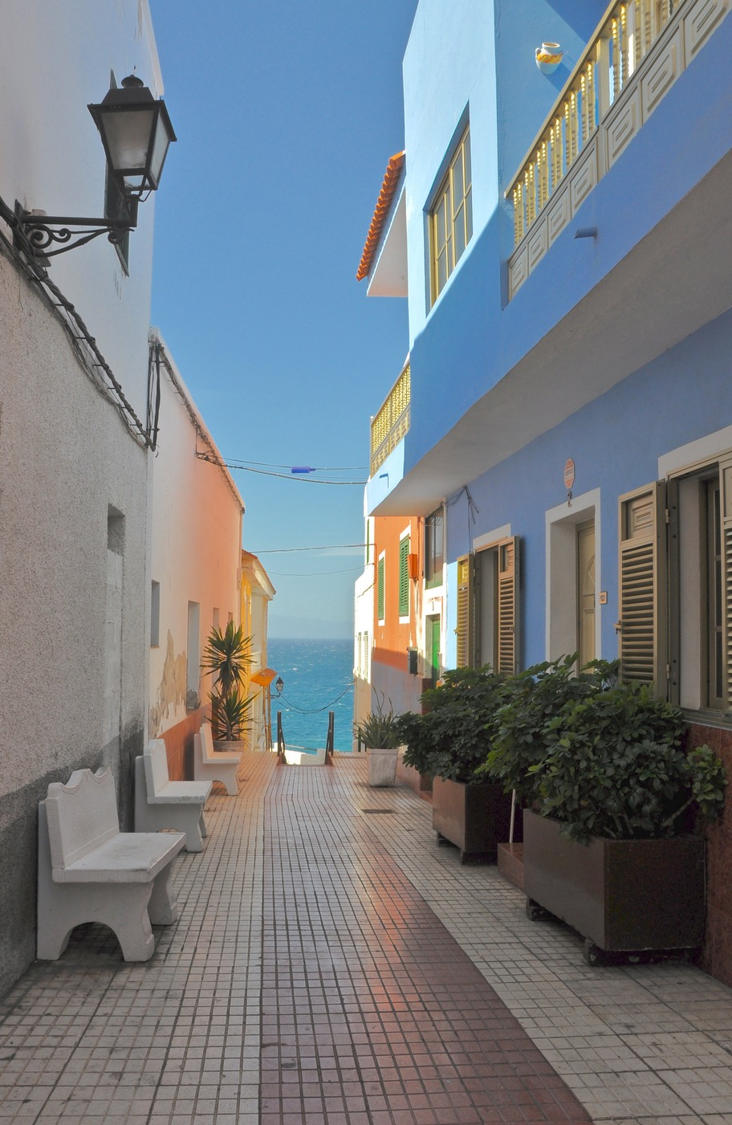
Man 1

Slide 3
A nice use of shadow and light to take your eye down the street, the lightness from the sky draws your eye from the bottom of the image to the nice blue cloudless sky a pleasing image.

Slide 4
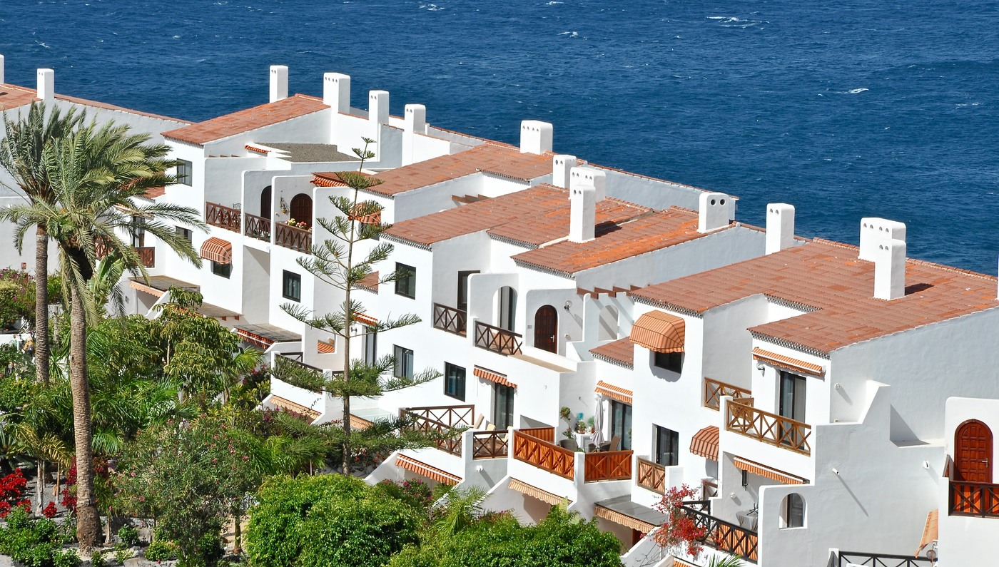
Man 2

Slide 5
A typical holiday image showing detail in the white building exposure as been controlled well composition wise I would have liked the building to be going from bottom left to top right a manipulated comp so easy to turn but pleasing image.

Slide 6
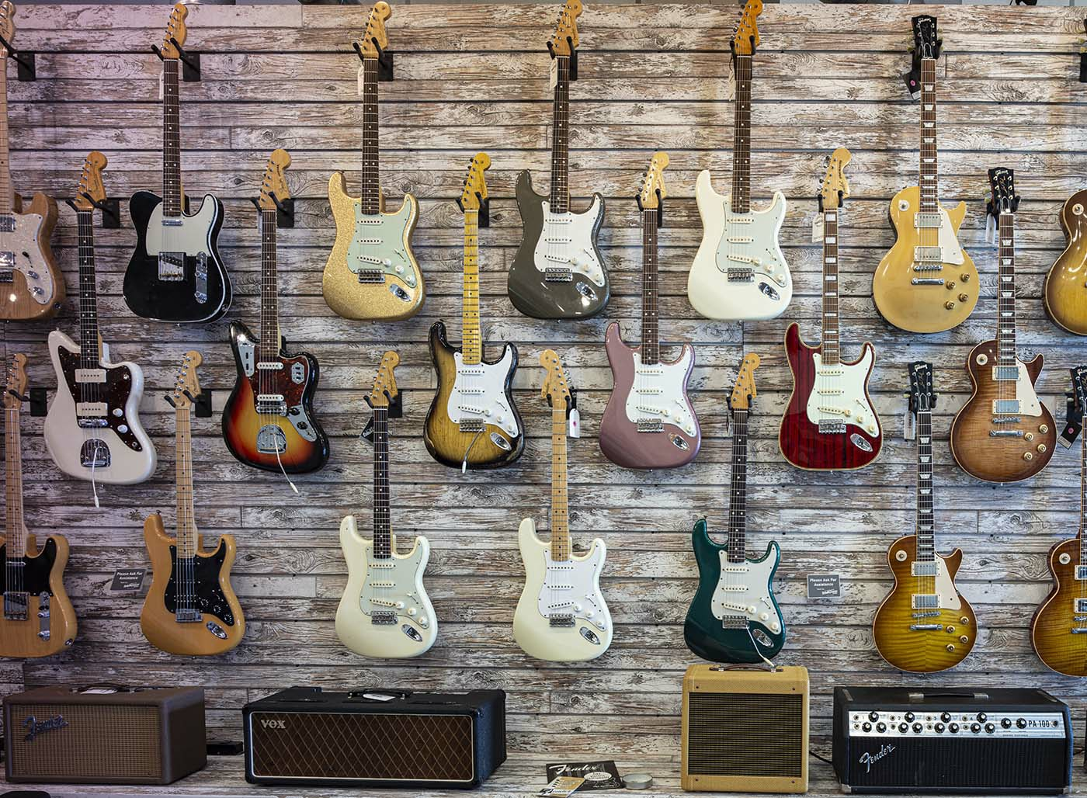
Man 3

Slide 7
This is a well seen image and some playing on my heart strings lol. With the love of guitars.
I like the composition of the amps lay’ed along the bottom of the image to give it a Base to stand on nice.

Slide 8
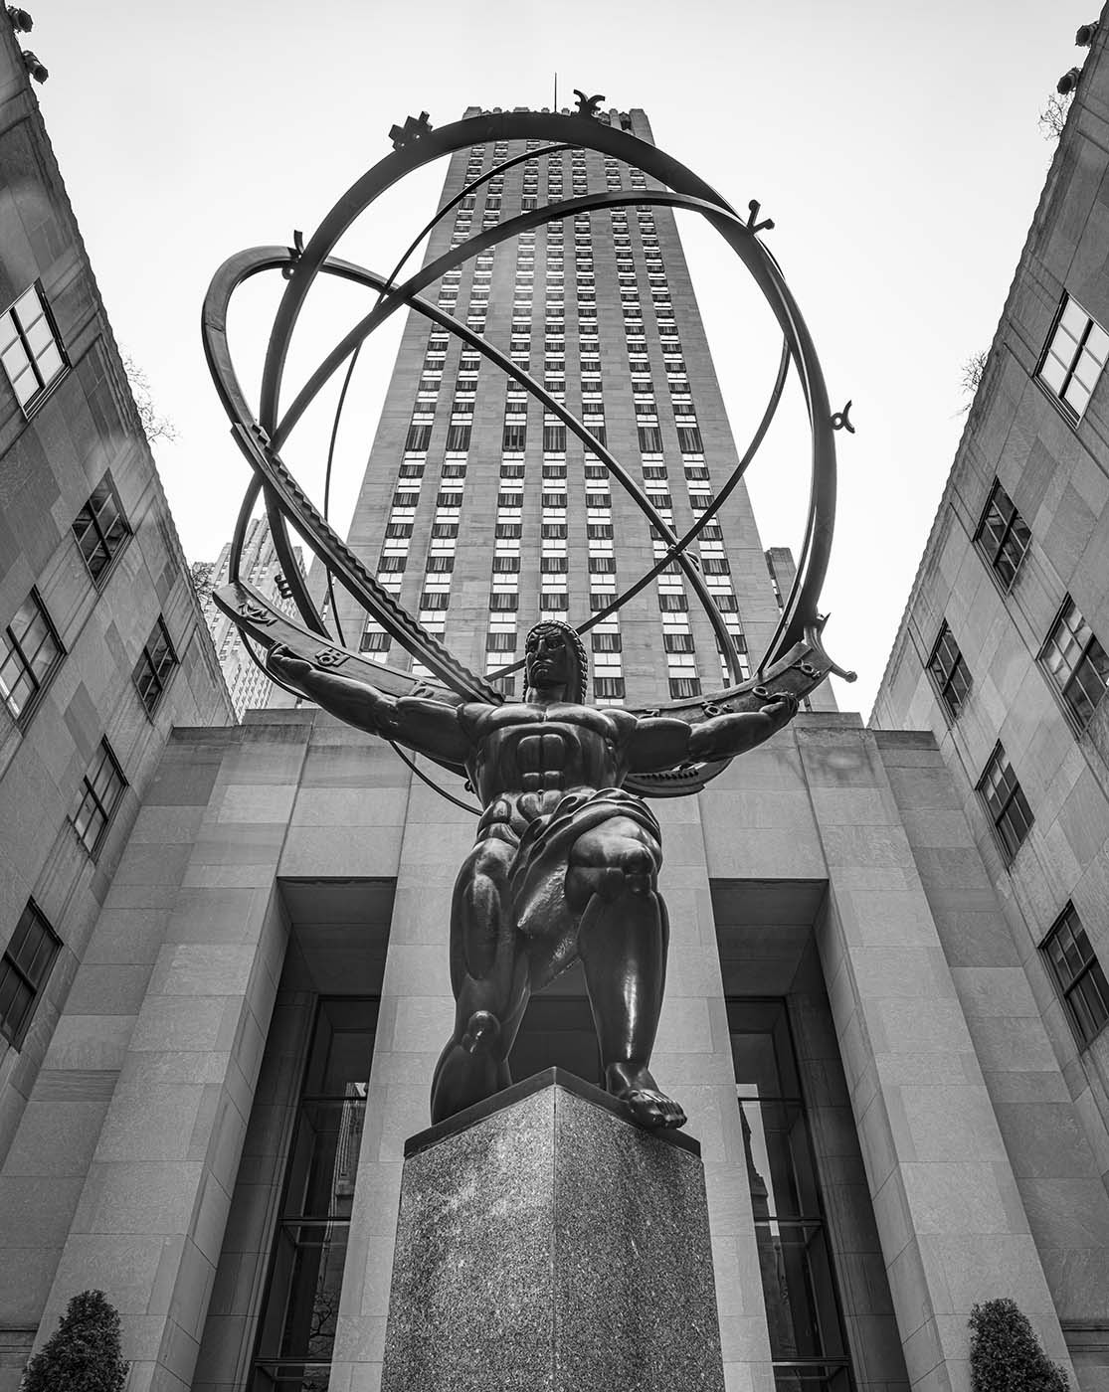
Man 4

Slide 9
A well composed monochrome image I thought the author could have manipulated the sky just enough to take the brightness away from it but well seen and completed.

Slide 10
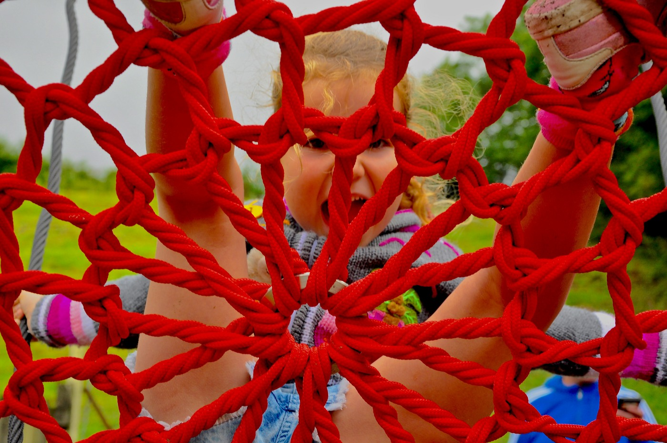
Man 5

Slide 11
A different angle on a outdoor street photography I think it had been over exposed or colours have been manipulated and felt it hurt my eyes after a short time with 99% of the image been that bright red.But having said that , nice to see photographer trying something different. Well done.

Slide 12
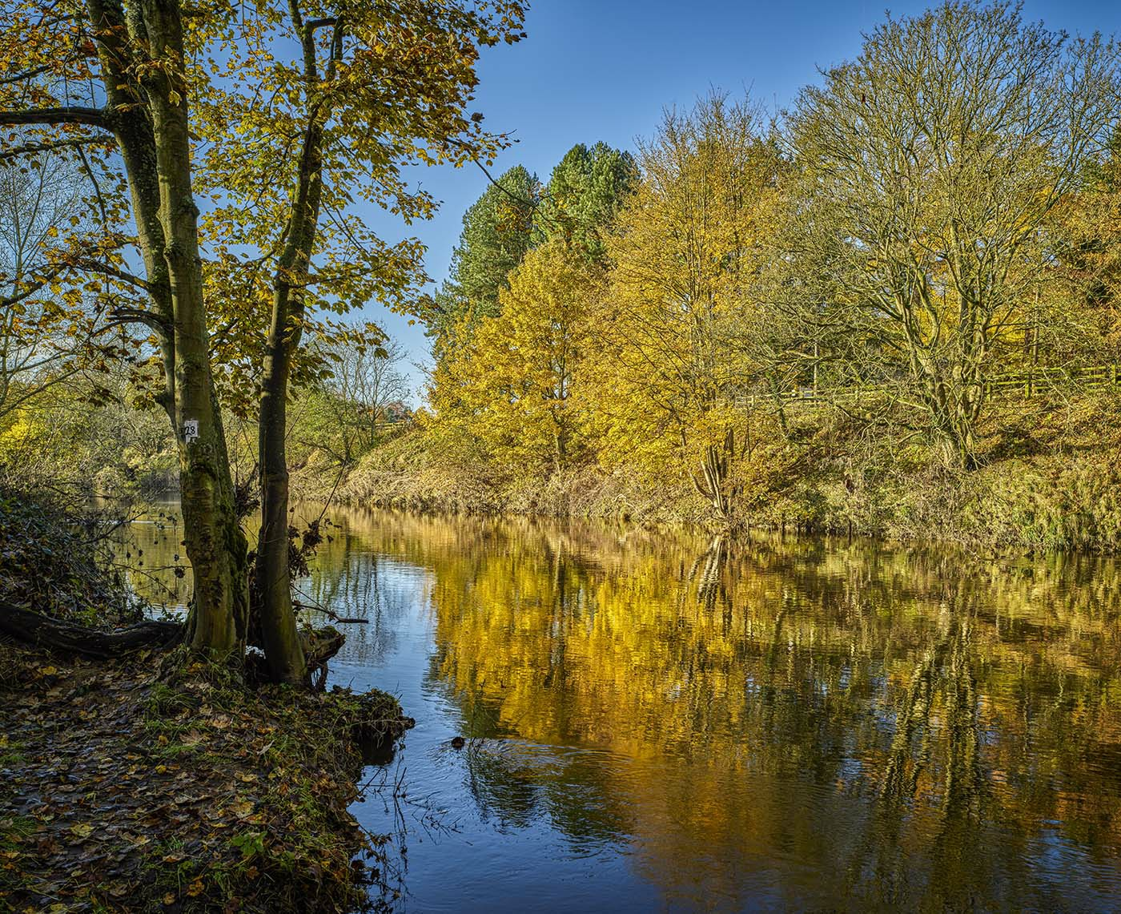
Man 6

Slide 13
A very nice landscape with every thing in , sharpness from front to back, exposure has been controlled well.
light ,shadow ,reflections and a good use of filling the blue but bland sky with the tree line a very pleasing photograph. Well done

Slide 14
Manipulated Results

Slide 15
Top Spots
From 6th Place
To
1st Place

Slide 16
6th Place
Alan Musgrove

Slide 17
5th Place
Phillip Yuill

Slide 18
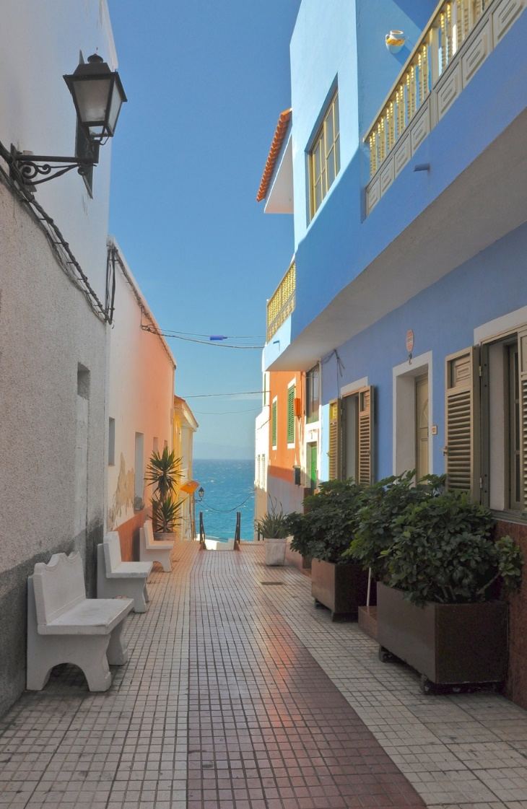
4th Place
Alan Musgrove

Slide 19
3rd Place
Alan Musgrove

Slide 20
2nd Place
Phillip Yuill

Slide 21
1st Place
Phillip Yuill

Slide 22
December Manipulated Enprint Competition
Thank you for your attention

