Slide 1
Hartlepool Camera Club
January 2022 Manipulated Enprint Appraisal
Dave Murrell 10/1/2022

Slide 2
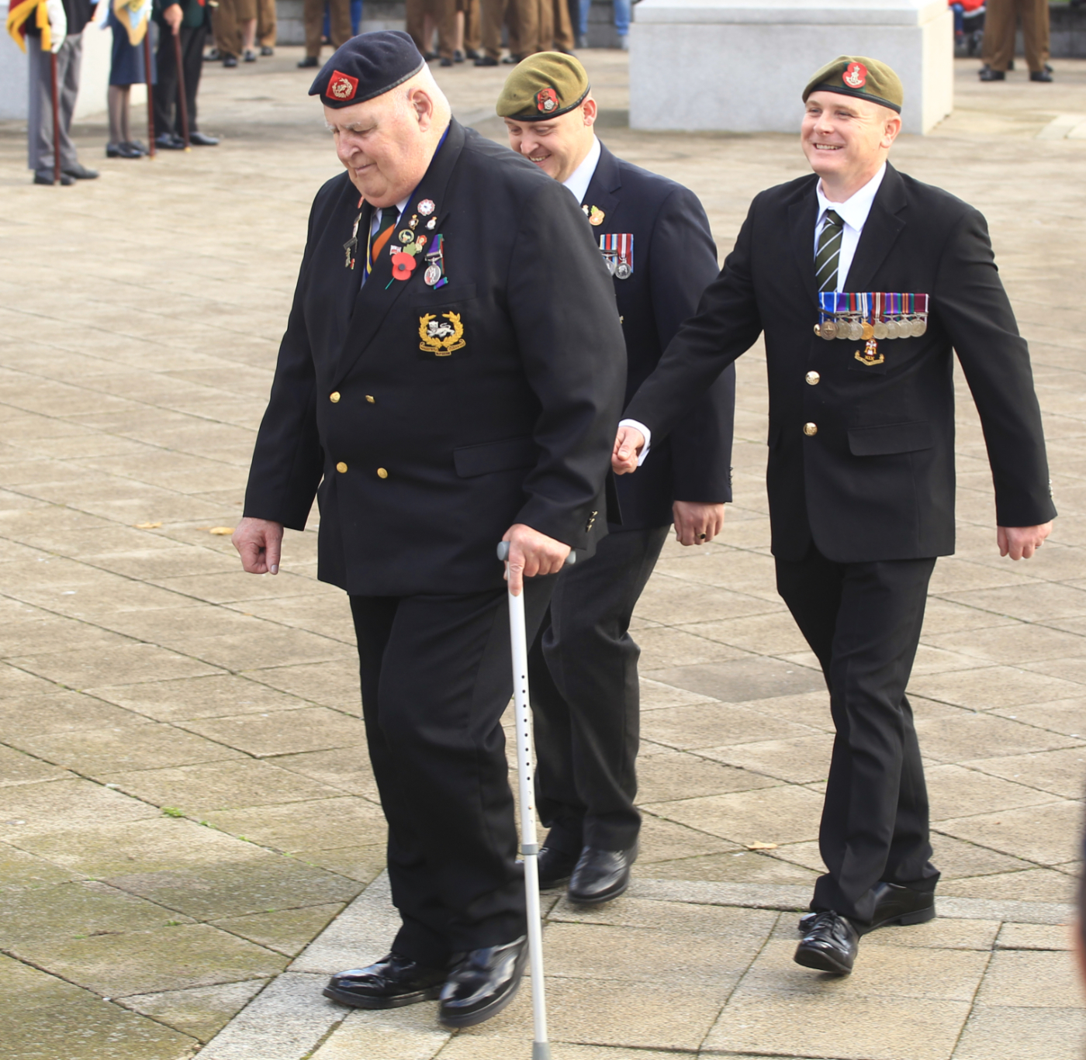
Notes:
Three proud ex servicemen in a moment of pride during this sombre parade.
The exposure is well handled although the highlights on the white collars is a little blown but nothing serious.
Im unsure if the square format works, yes it lets us know what we have to focus on but it doesn’t but it in context. It may have been nice to see more of people in the periphery of the image and give the lads somewhere to march into.
I’d have removed the arm on the right and try to include all of the walking stick.
This is still a powerful thought provoking image of proud people who served this country because they wanted to.

Slide 3
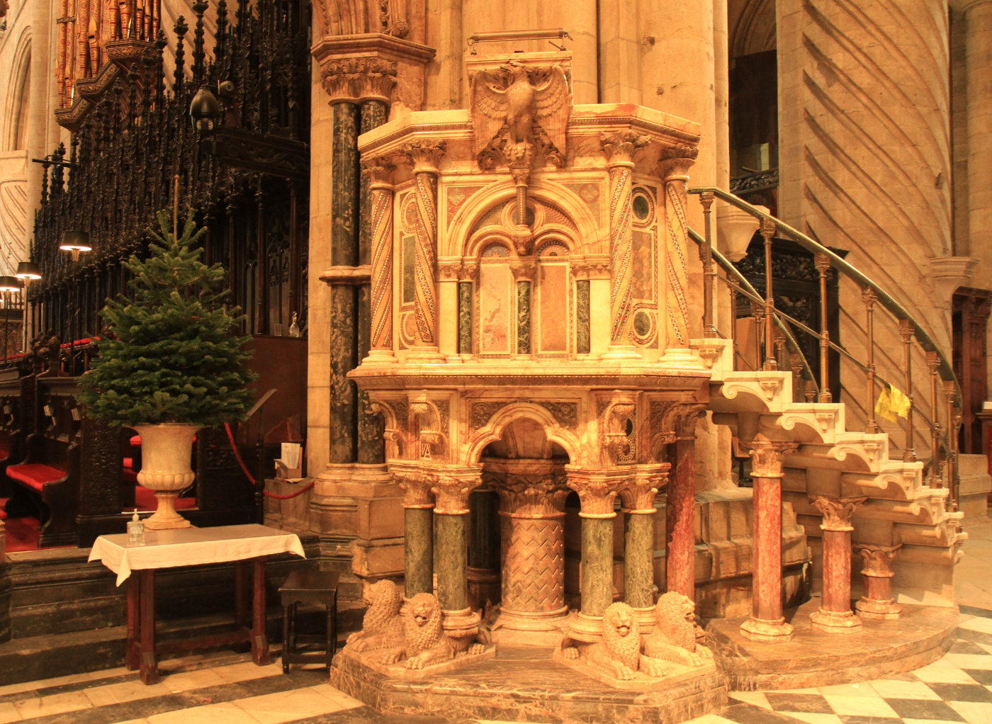
Notes:
The golden ornate lectern in Durham Cathedral in all of its Christmas glory.
Good perspective gives us most of the lectern (part of there base is clipped. Important for architecture I think). And the Christmas tree sets the season for us.
We have detail throughout but I feel the image is a little flat and a lift in contrast by pulling the darks down a little as this would set the lectern apart from its surroundings as its a little lost against the pillars.
I would reduce the white balance a little as the image is very yellow.

Slide 4
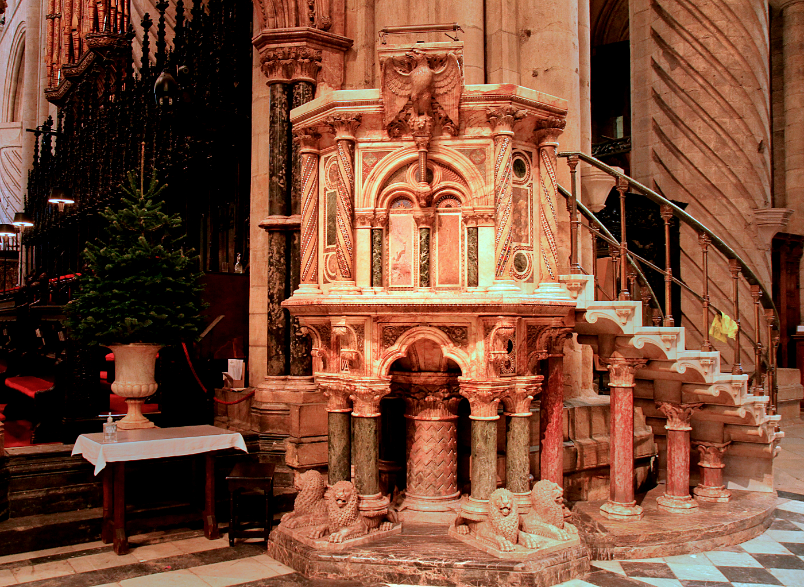
Notes:
We’ve altered the contrast, the darks on the left aren’t important t your subject but help frame it, We’ve altered the white balance and increased detail.
I think the dark areas now allow the lectern to stand out and become the focal point.
Think I’d have moved the duster!
This is an interesting composition drawing us to the lectern and again reminding us with the Christmas tree why the building is there.

Slide 5
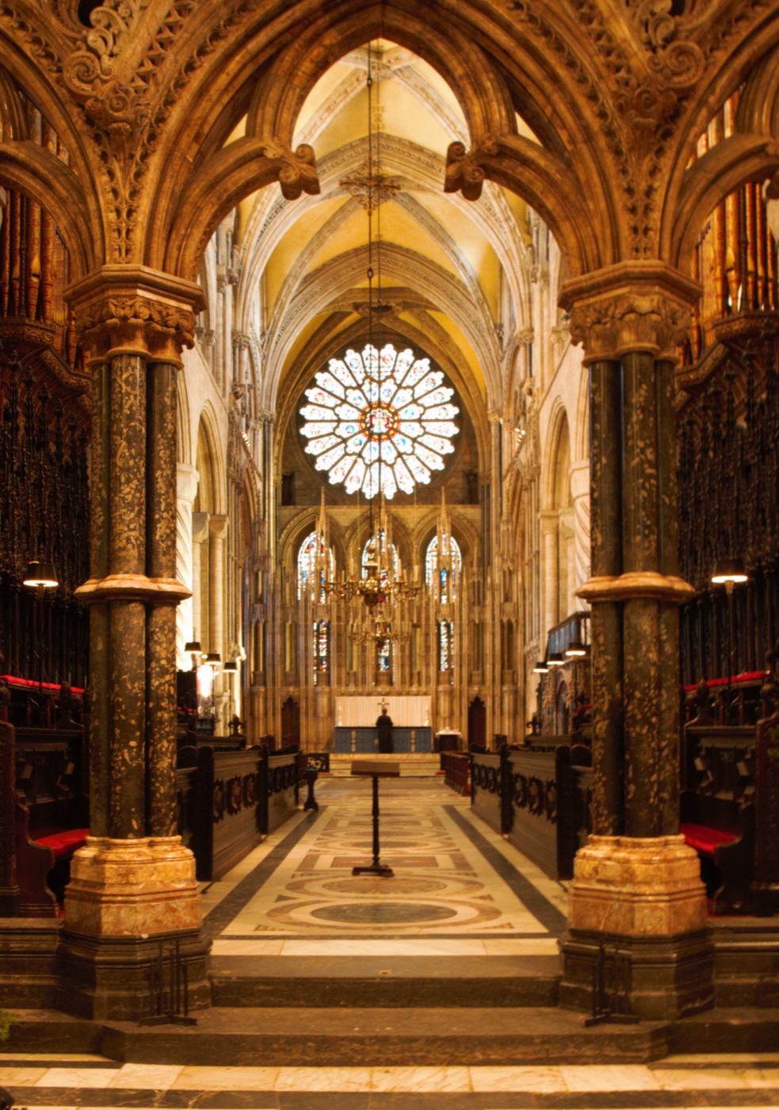
Notes:
A great perspective of the Nave in Durham Cathedral.
Exposure is good as the darker sides guide us to the alter where we have a priest praying.
This is a very slow shutter speed of 1/6th second and high ISO which has lead to a slightly soft image but we can still enjoy the details of our surroundings.
A good architectural shot with vertical verticals

Slide 6
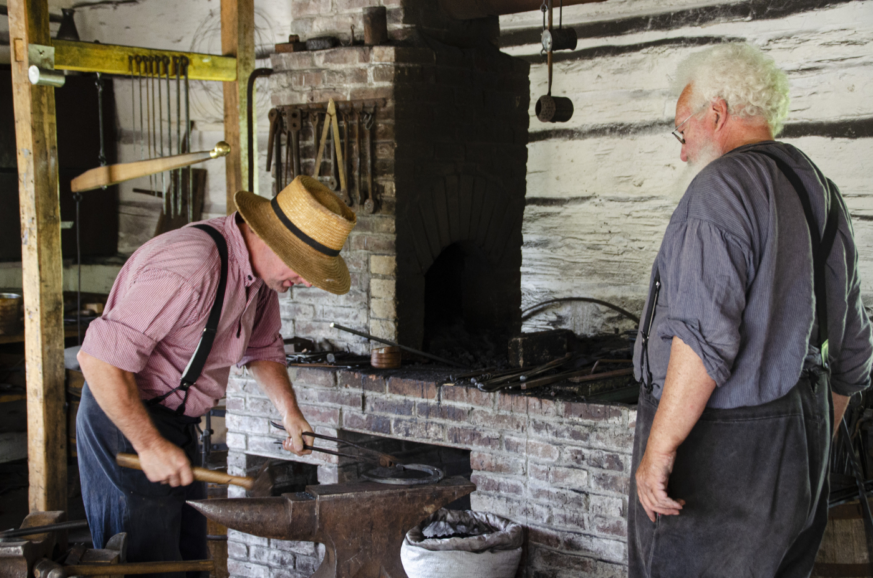
Notes:
The Smithy at work, Note the correct PPE, a straw hat!
Good exposure and plenty of detail to enjoy, I like the movement of the hammer.
Its highly cropped to the two characters but maybe opening the image up a little to capture more of the anvil and what its standing on would balance the bottom of the image as it appears to be floating a little.
An interesting take of men at work, concentrating on the task in hand.

Slide 7
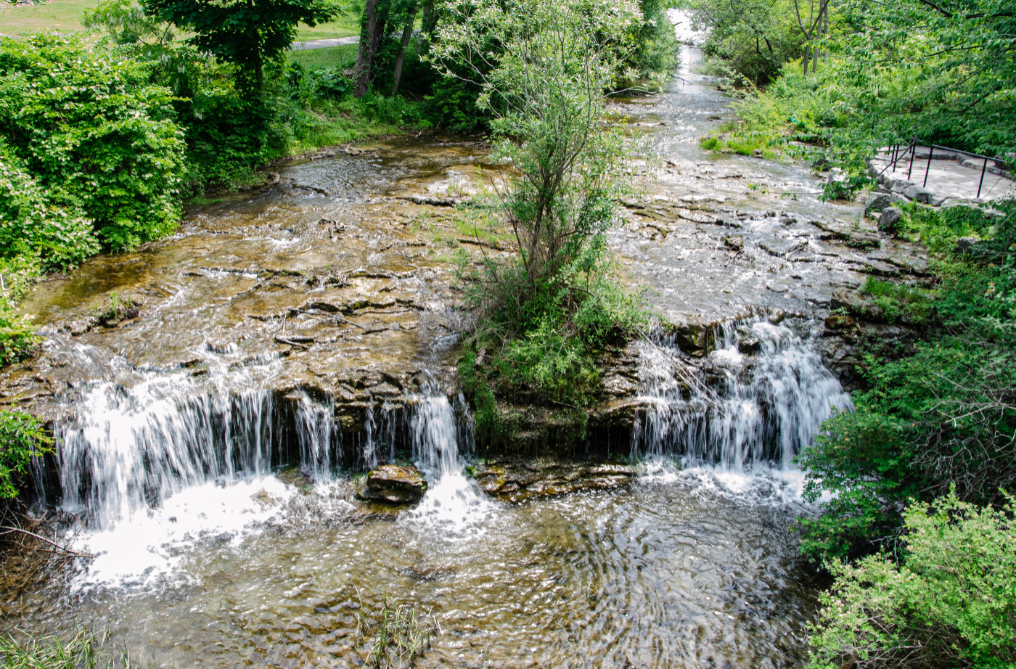
Notes:
Small cascades captured with a relatively slow shutter speed to add. Some movement to. The water.
Depending on how much movement you want to capture then a tripod or rest is essential for longer exposures than the 1/20th second of this capture.
It all depends on what effect you are trying to achieve.
We’ve overexposed the highlights in the water leaving no details so even trying to recover them we are left without any detail there.
It's maybe best to expose for the highlighted water and recover any underexposed areas in post production as the dynamic range of most modern digital cameras will have detail in the shadows waiting to be recovered.
That said the picture allows us to follow the stream towards us as it flows under a bridge or our photographers legs.

Slide 8
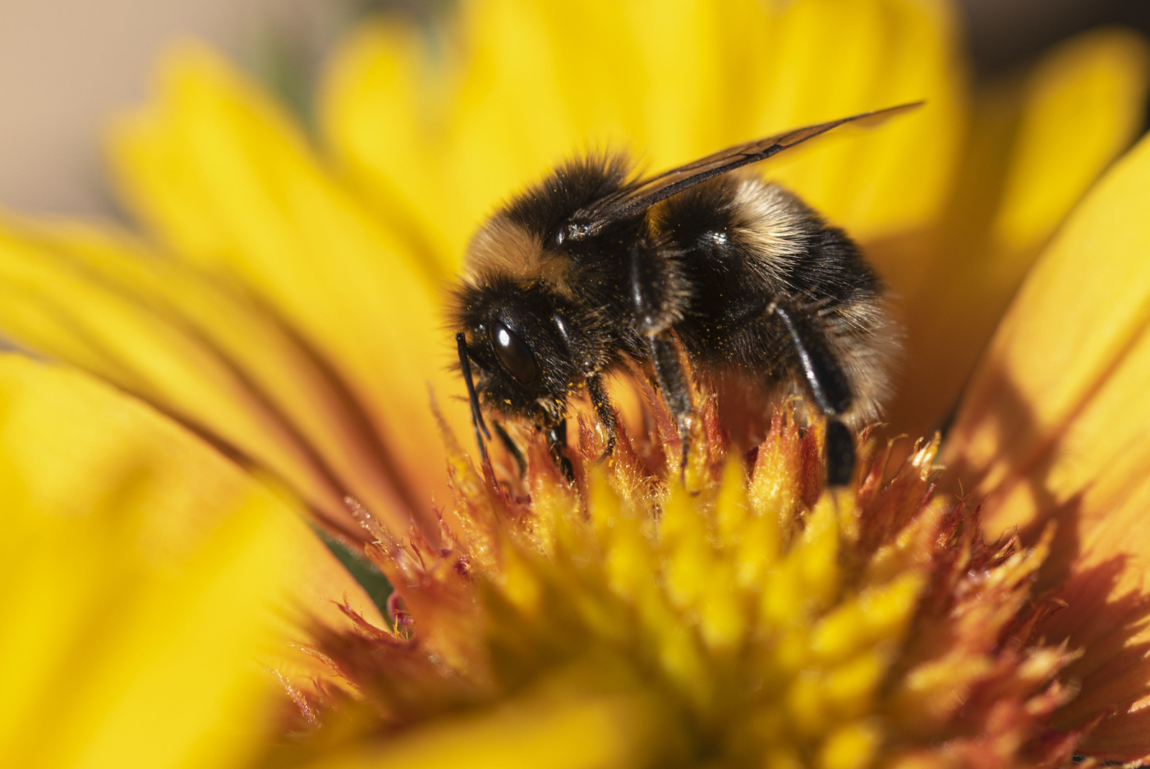
Notes:
Very striking capture of a humble Bumble Bee, becoming an endangered species,
Striking contrast between the yellow of the flower and the black of the Bee takes us to the bee.
And there are no distractions in the background or foreground with good separation of the subject.
Focus point is critical for macro work and on insects the head and eye are usually the critical points od focus due to very shallow depth of field and we’ve chosen an F5.6 aperture possibly to maintain a fast shutter speed to freeze the action but it looks like we’ve just missed focus on the eye.
None the less we still have a striking image with plenty of detail about the Bee to enjoy

Slide 9
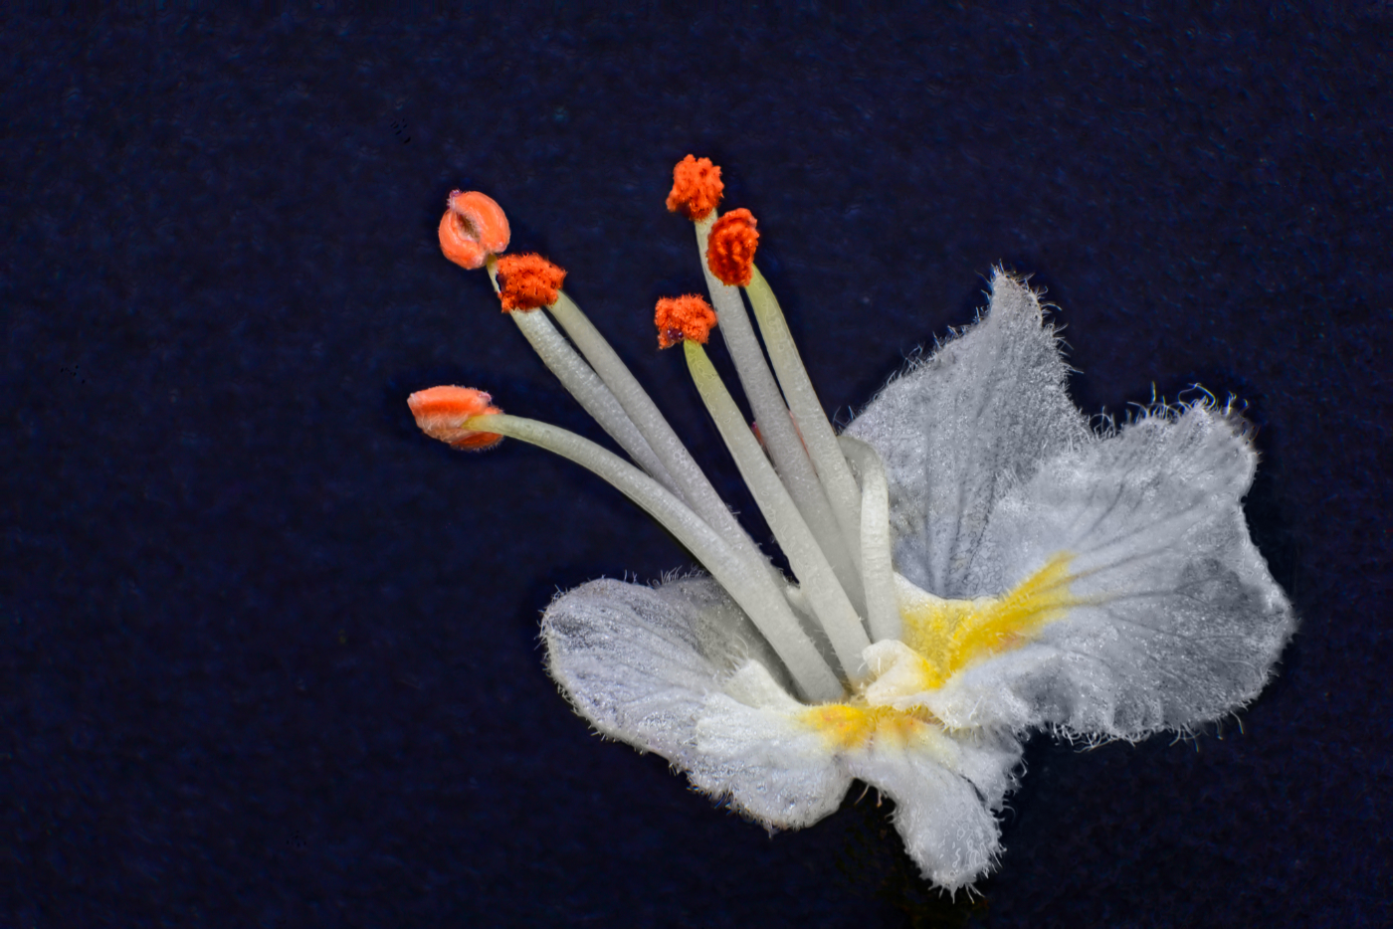
Notes:
A very intriguing still life, you can almost see the stamens growing out of the flower.
Great exposure gives us detail throughout to enjoy.
I don't know if the image has been focus stacked but again we have texture and detail throughout.
A well chosen background gives us complimentary textures to the flower.
A very pleasing image.

Slide 10
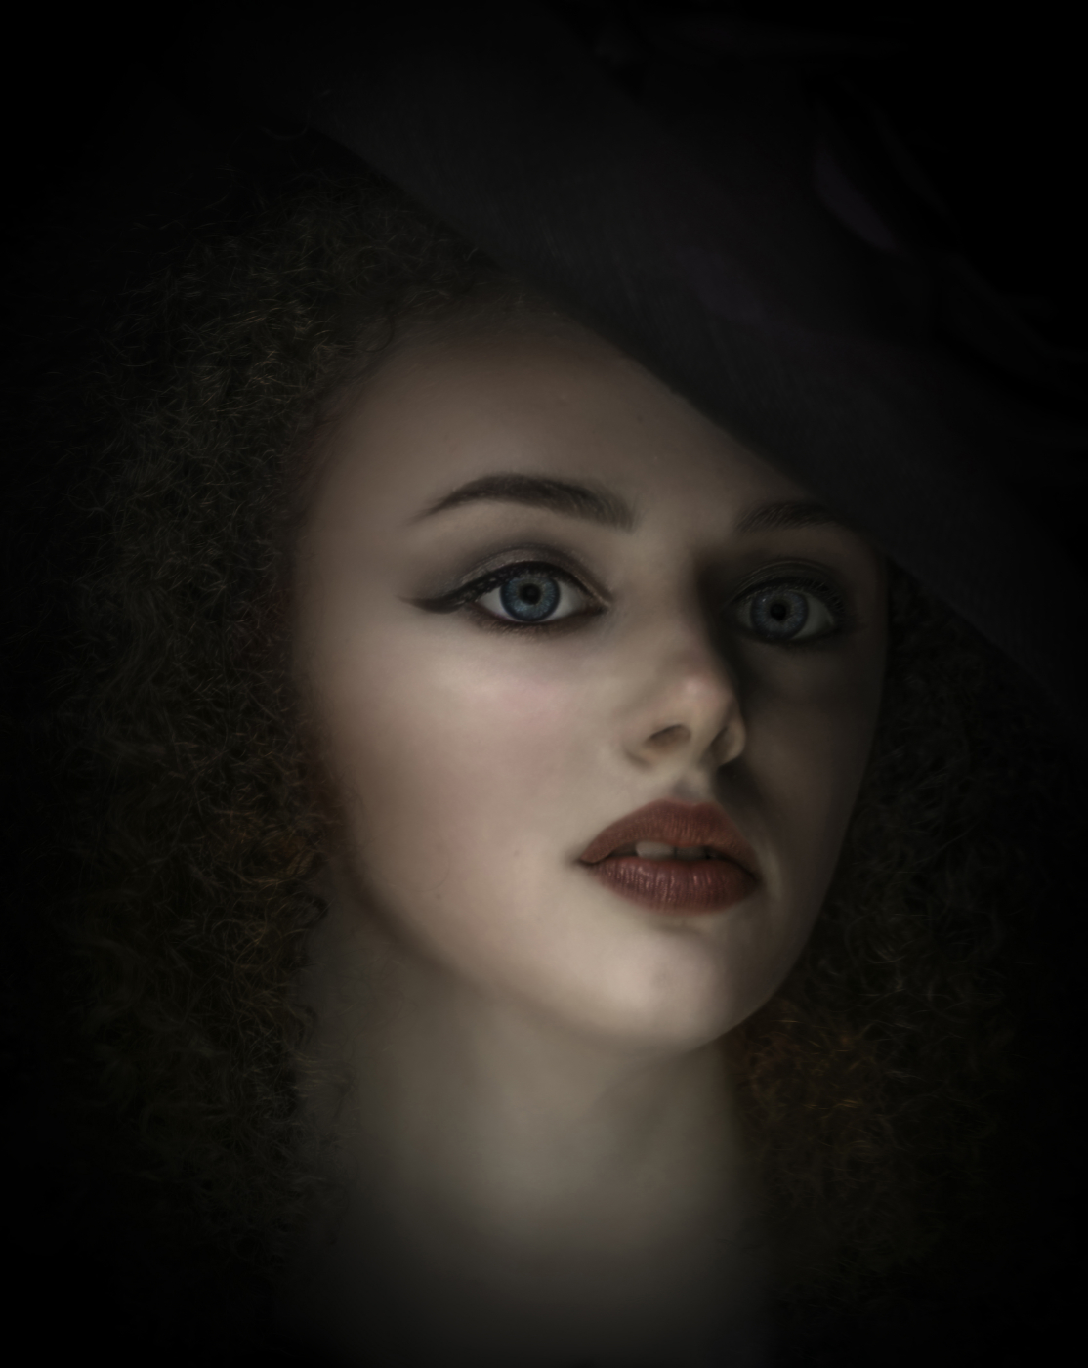
Notes:
A portrait of a blue eyed girl.
The skin tones give the impression of a pastel or chalk drawing, which may be our photographers intent.
The eyes look to be heavily processed and the absence of catch-lights gives them a flat feeling as our model gazes past the camera not engaging with us.
I’m unsure if the hat is an added feature but there is no shadows under the rim on the hair or her brow and the heavy vignette, which does focus on the face gives the head a “floating in space” appearance.
I notice that we’ve processed the image in PortraitPro software and the danger of using these programs is that we are tempted to use as many of the features as we can, which can lead to an over processed image.
Portrait photography is about preparation, The models make up should be sorted then lighting and finally there should be minimal post editing required.
That said we have been presented with an intriguing image and we wonder what the girl is pondering as she looks lost in her own thoughts.

Slide 11
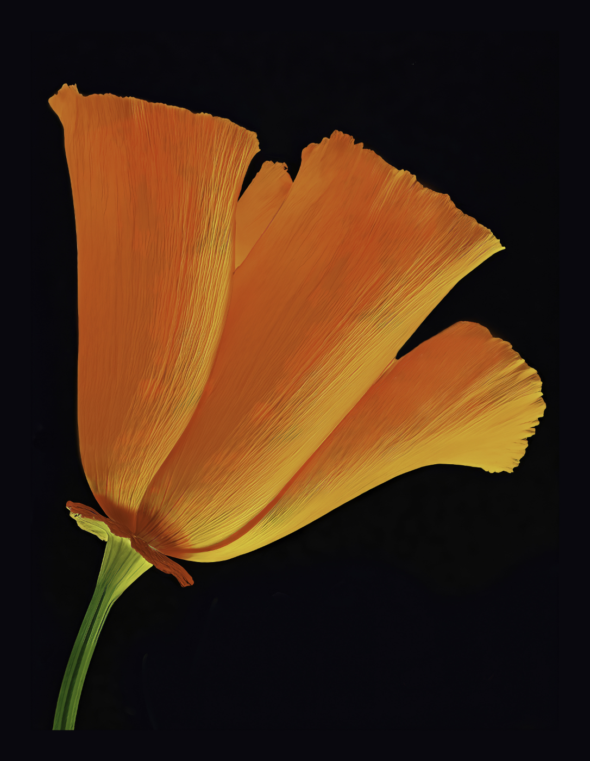
Notes:
A high contrast still life where we are drawn straightaway to the bright petals set against a black background.
The textures in the petals and stalk flow in lines giving the impression of flowing oil paints.
The highly defined edges of the flower give me the impression of it being cut out and placed on the background but it doesn’t matter as we’ve been presented with an almost abstract painterly image
That holds our attention as we explore those textures.

Slide 12
Thank you
Dave Murrell 10/1/2022

