Slide 1
HCC 2021 Enprints Competition Manipulated Entries
December 2021
Judged By
Philip Kilburn

Slide 2
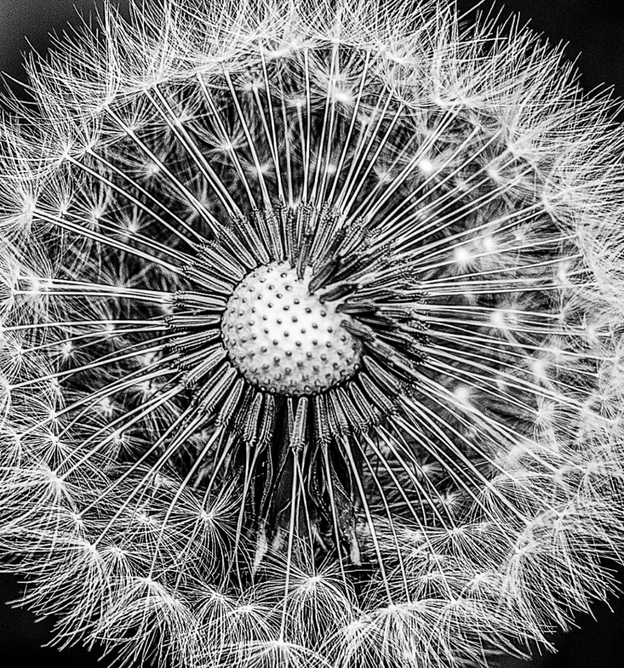
Man 1

Slide 3
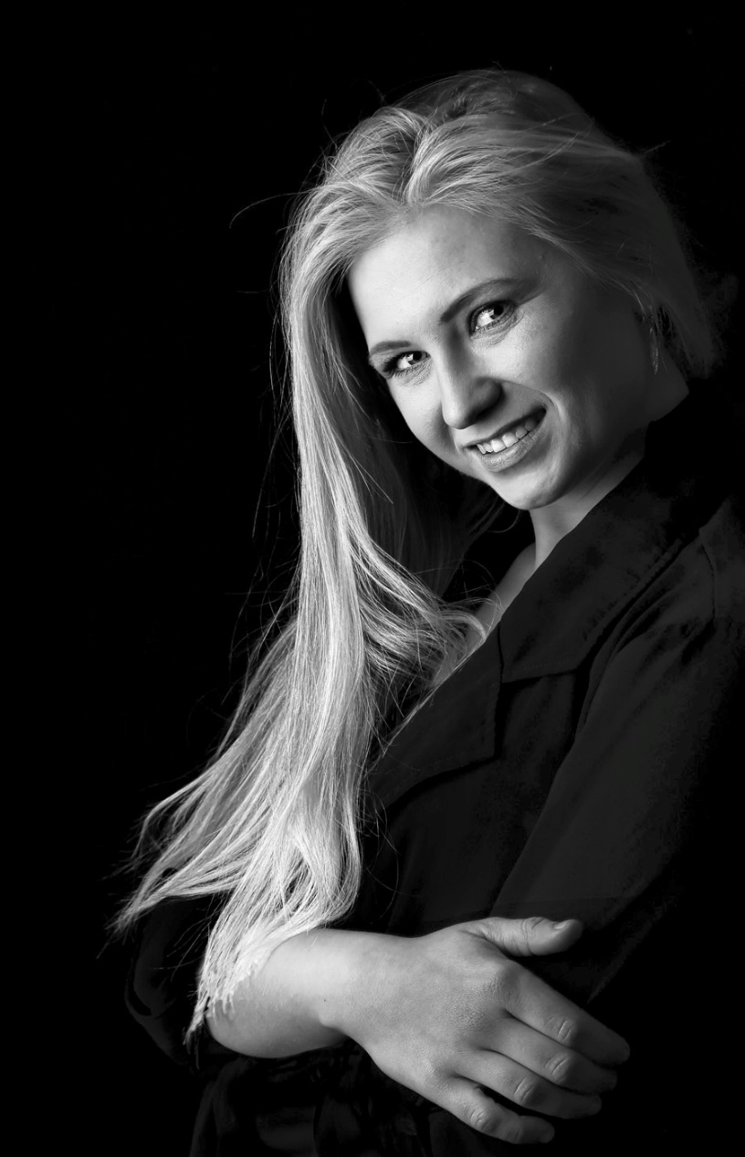
Man 2

Slide 4
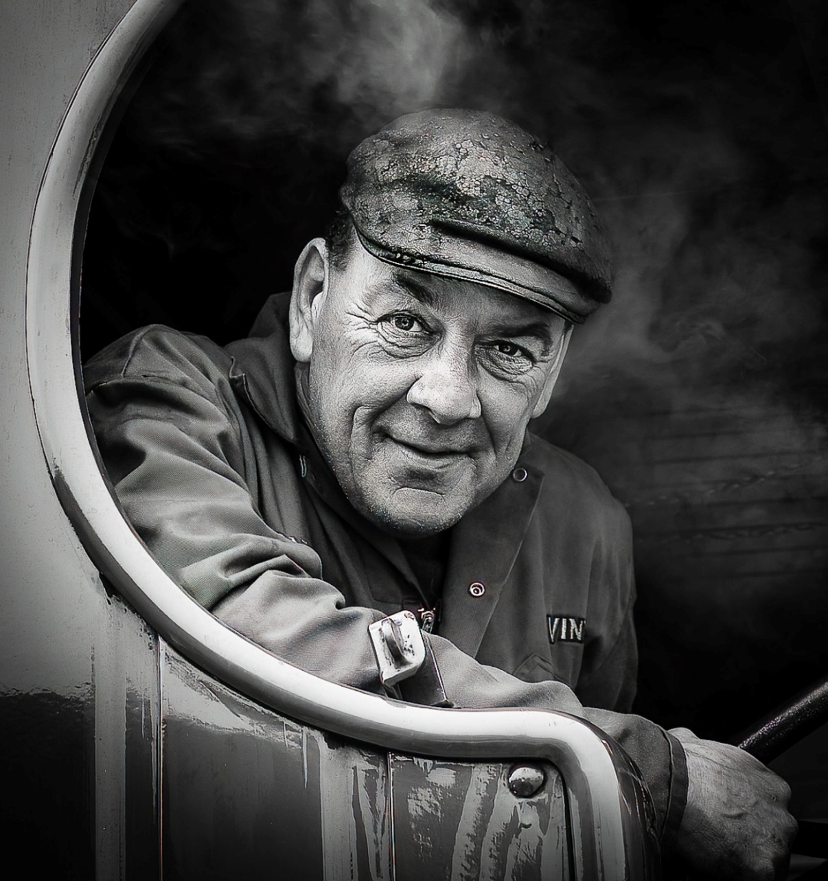
Man 3

Slide 5
Man 4

Slide 6
Man 5

Slide 7
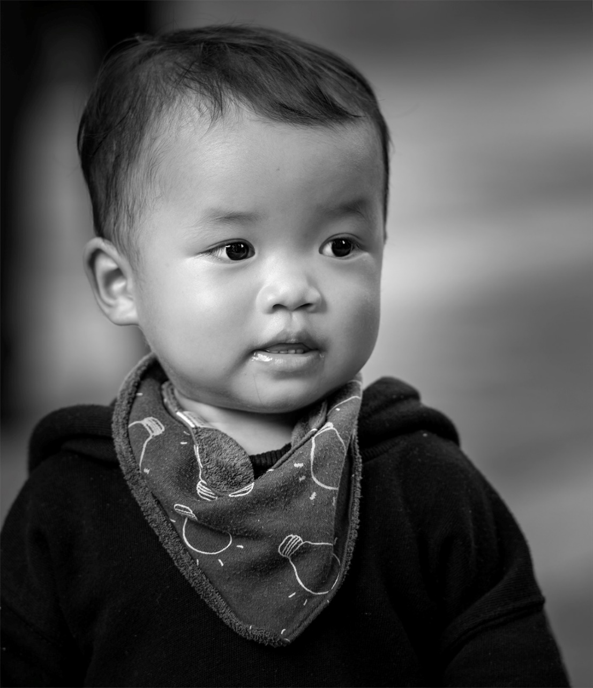
Man 6

Slide 8
Man 7

Slide 9
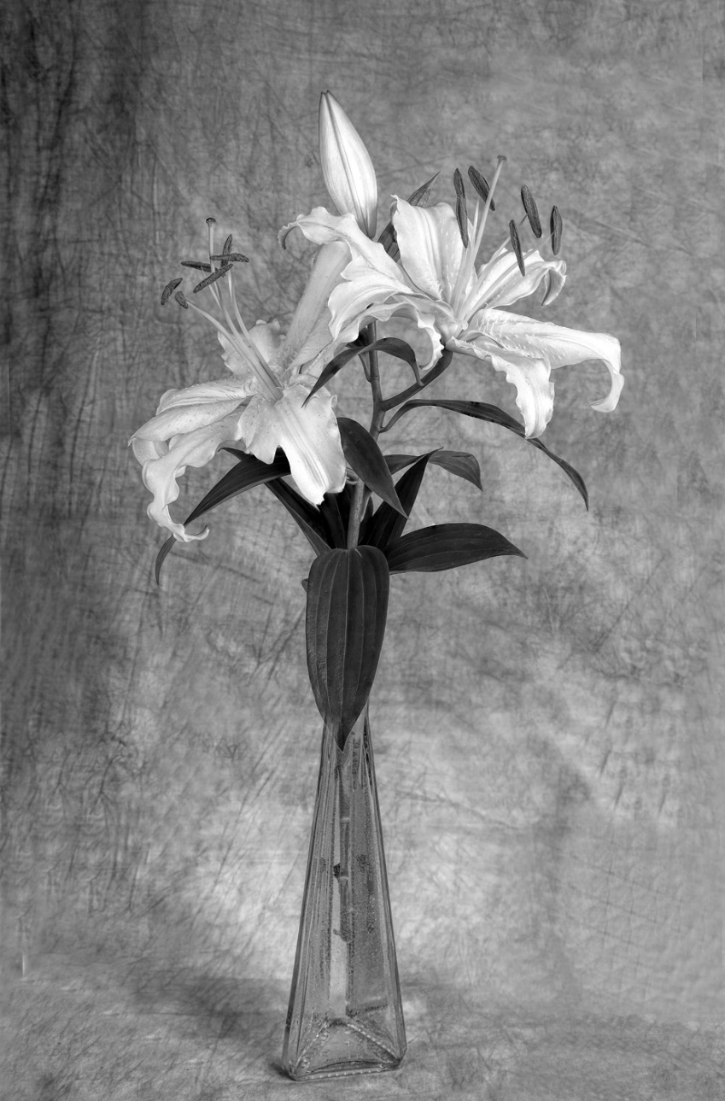
Man 8

Slide 10
Man 9

Slide 11
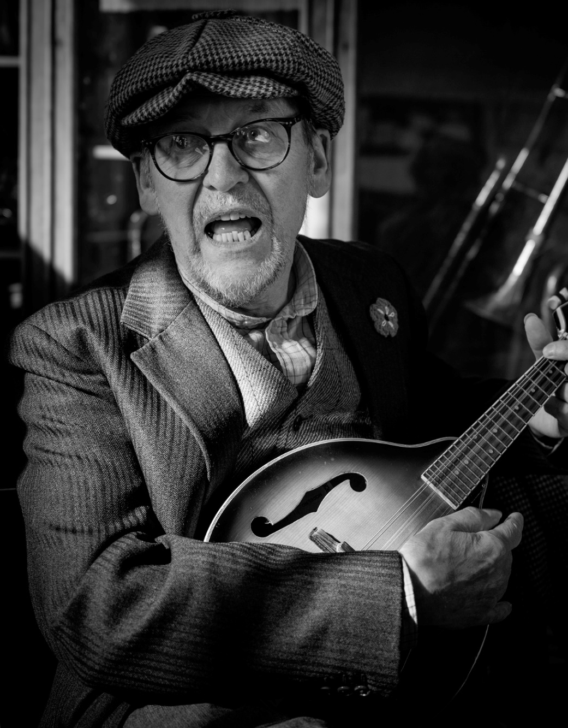
Man 10

Slide 12
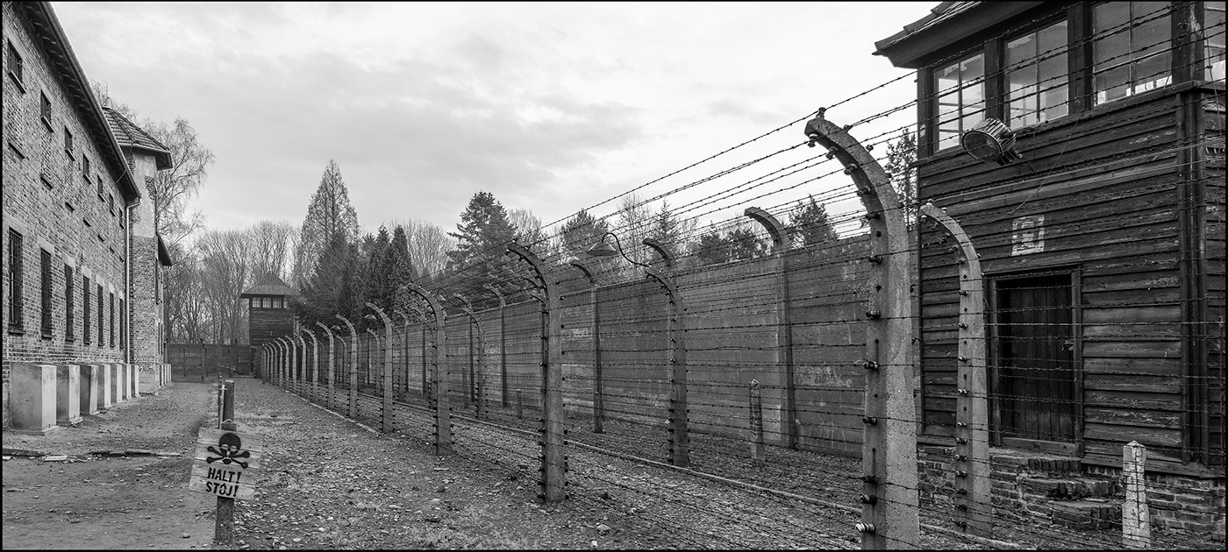
Man 11

Slide 13
Man 12

Slide 14
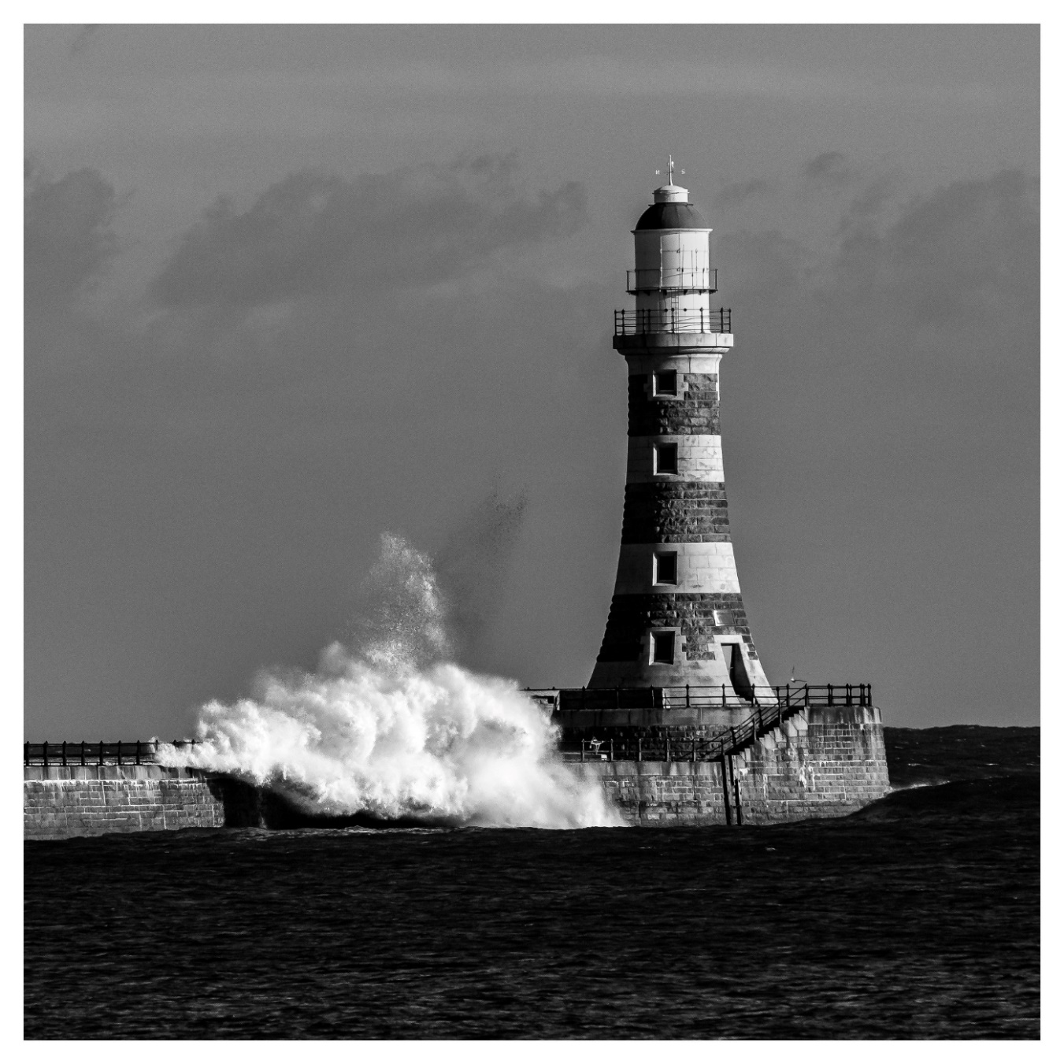
Man 13

Slide 15
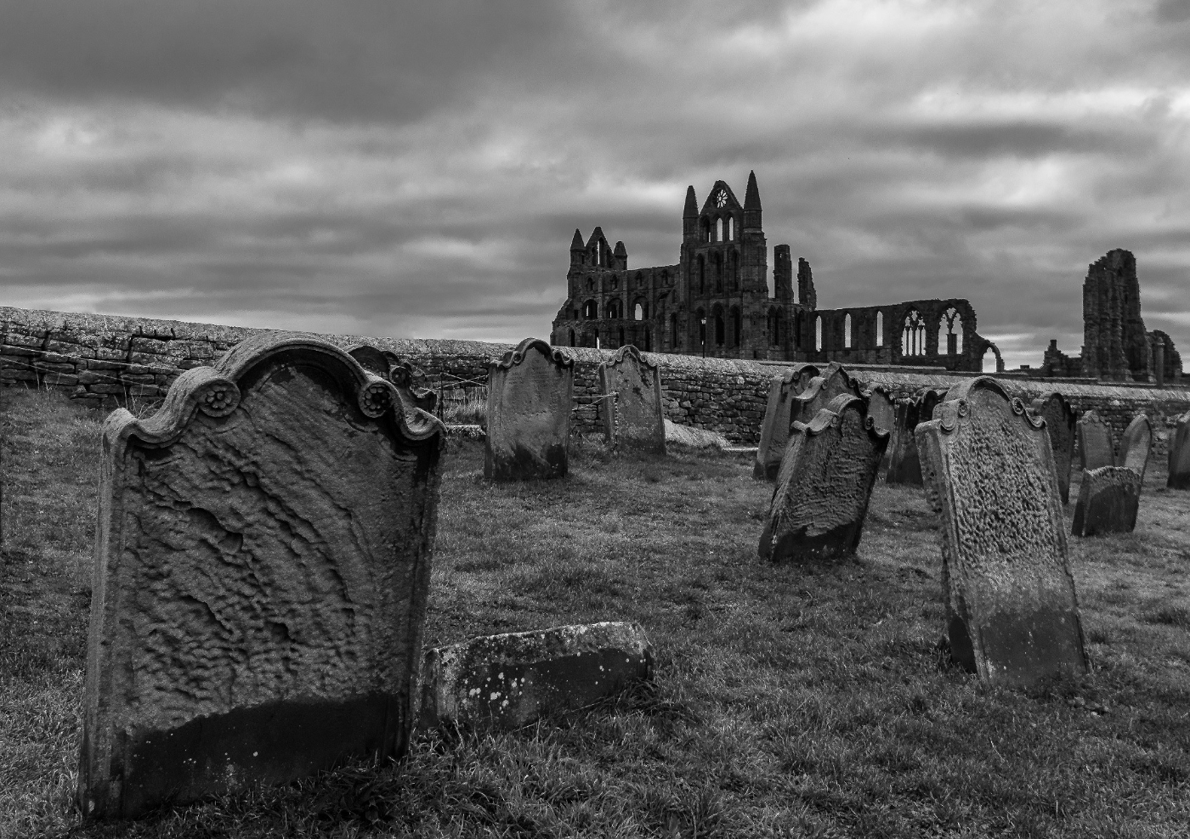
Man 14

Slide 16
Man 15

Slide 17
Manipulated Results

Slide 18
Highly Commended

Slide 19
Harry Brenkley

Slide 20
Harry Brenkley

Slide 21
Phillip Yuill

Slide 22
Harry Brenkley

Slide 23
Thomas Maddison

Slide 24
Thomas Maddison

Slide 25
Bev Trainer

Slide 26
Bev Trainer

Slide 27
Bev Trainer

Slide 28
Top Spots
From 6th Place
To
1st Place

Slide 29
6th Place
Phillip Yuill

Slide 30
5th Place
Phillip Yuill

Slide 31
4th Place
Tom Maddison

Slide 32
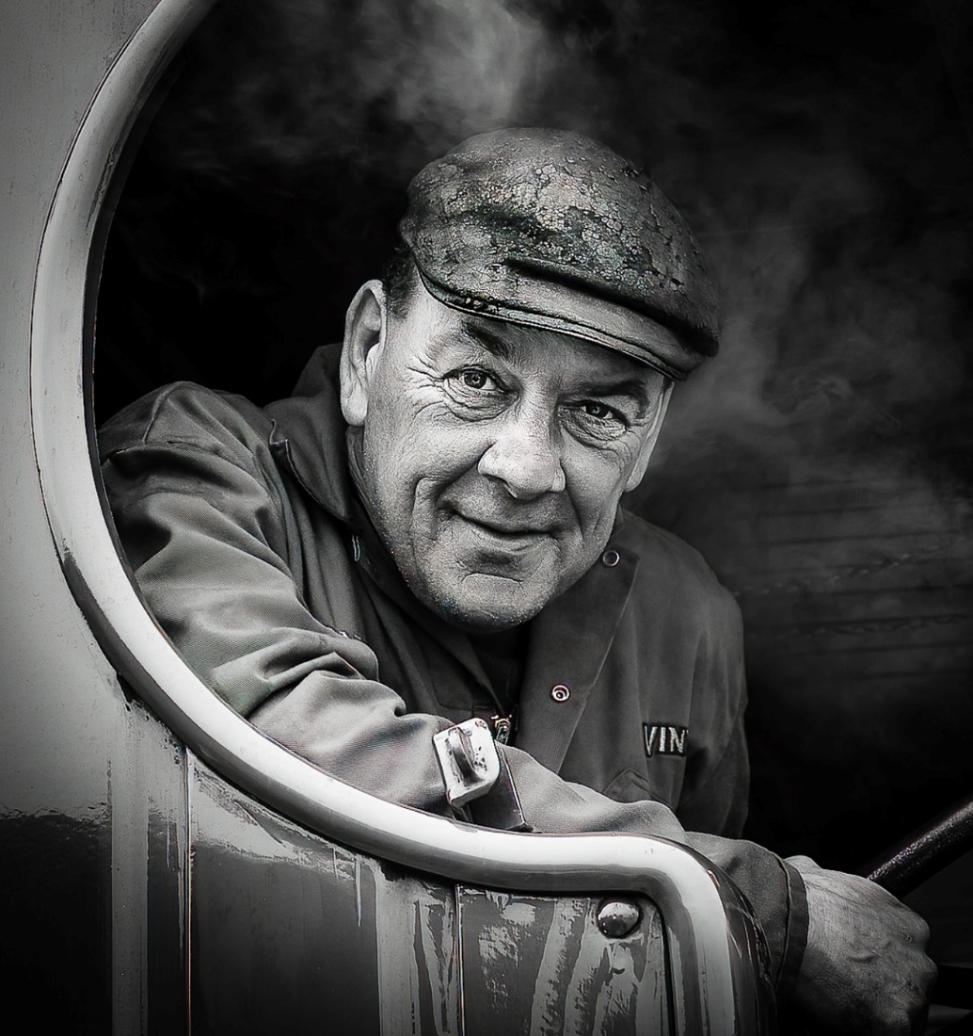
3rd Place
David Kay

Slide 33
2nd Place
David Kay

Slide 34
1st Place
David Kay

Slide 35
December Manipulated Enprint Competition
Well done and thank you Phil
Thank you for your attention

