Slide 1
HCC Enprints Competition Manipulated Entries
March 2019
Judged By
Brendan Magennis

Slide 3
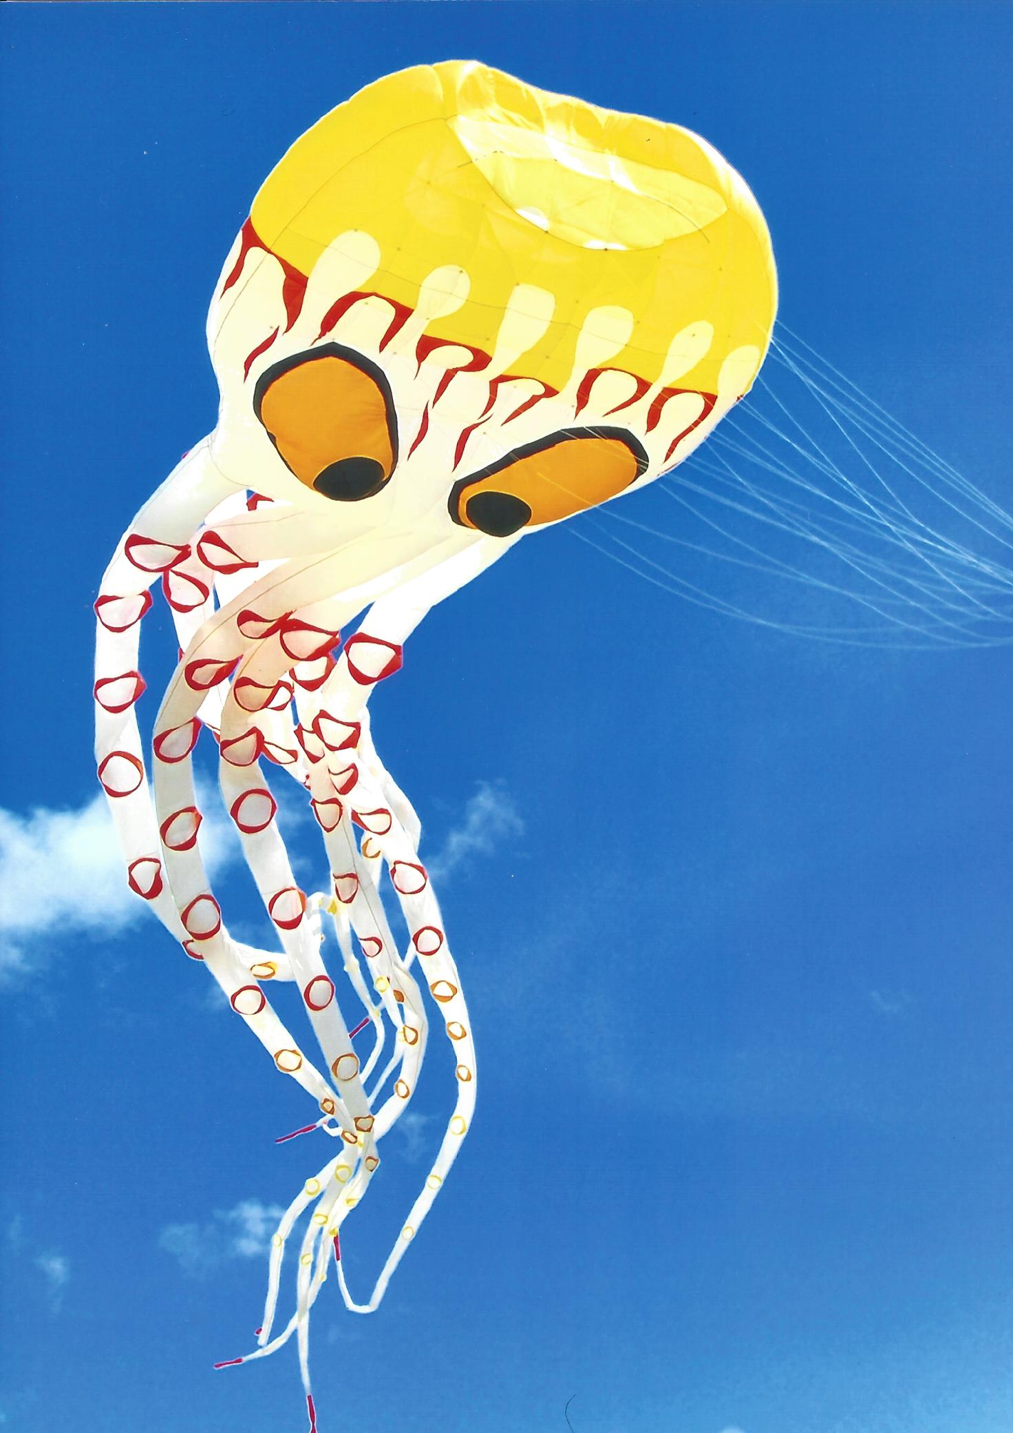

Slide 6
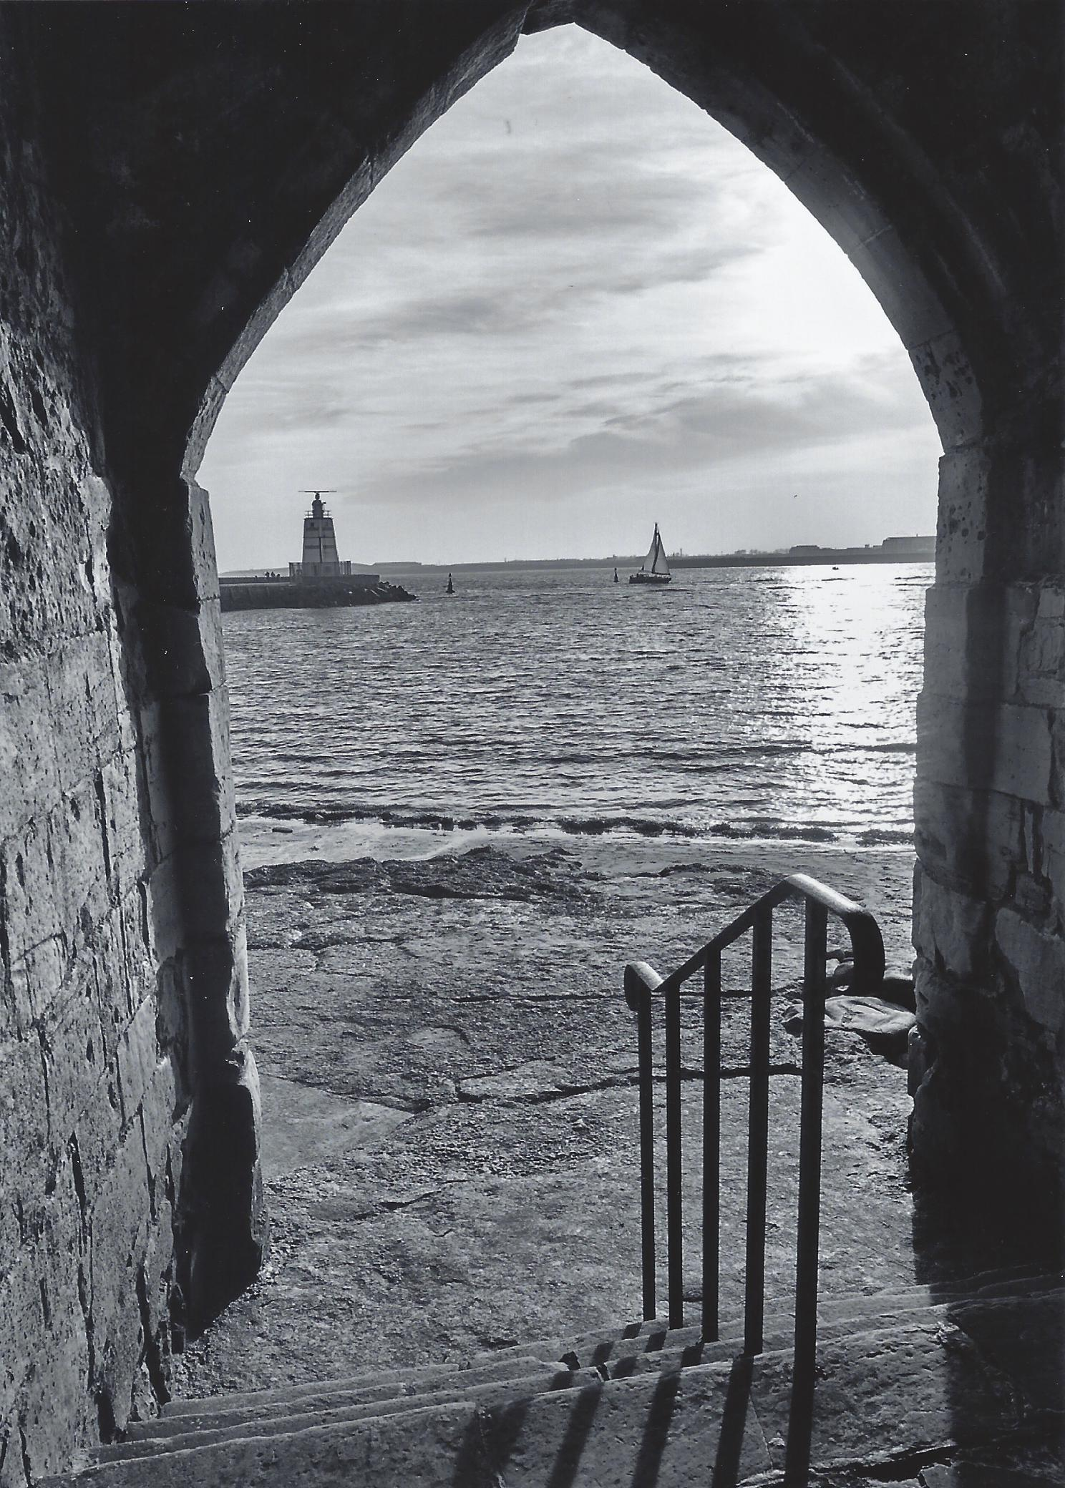

Slide 8
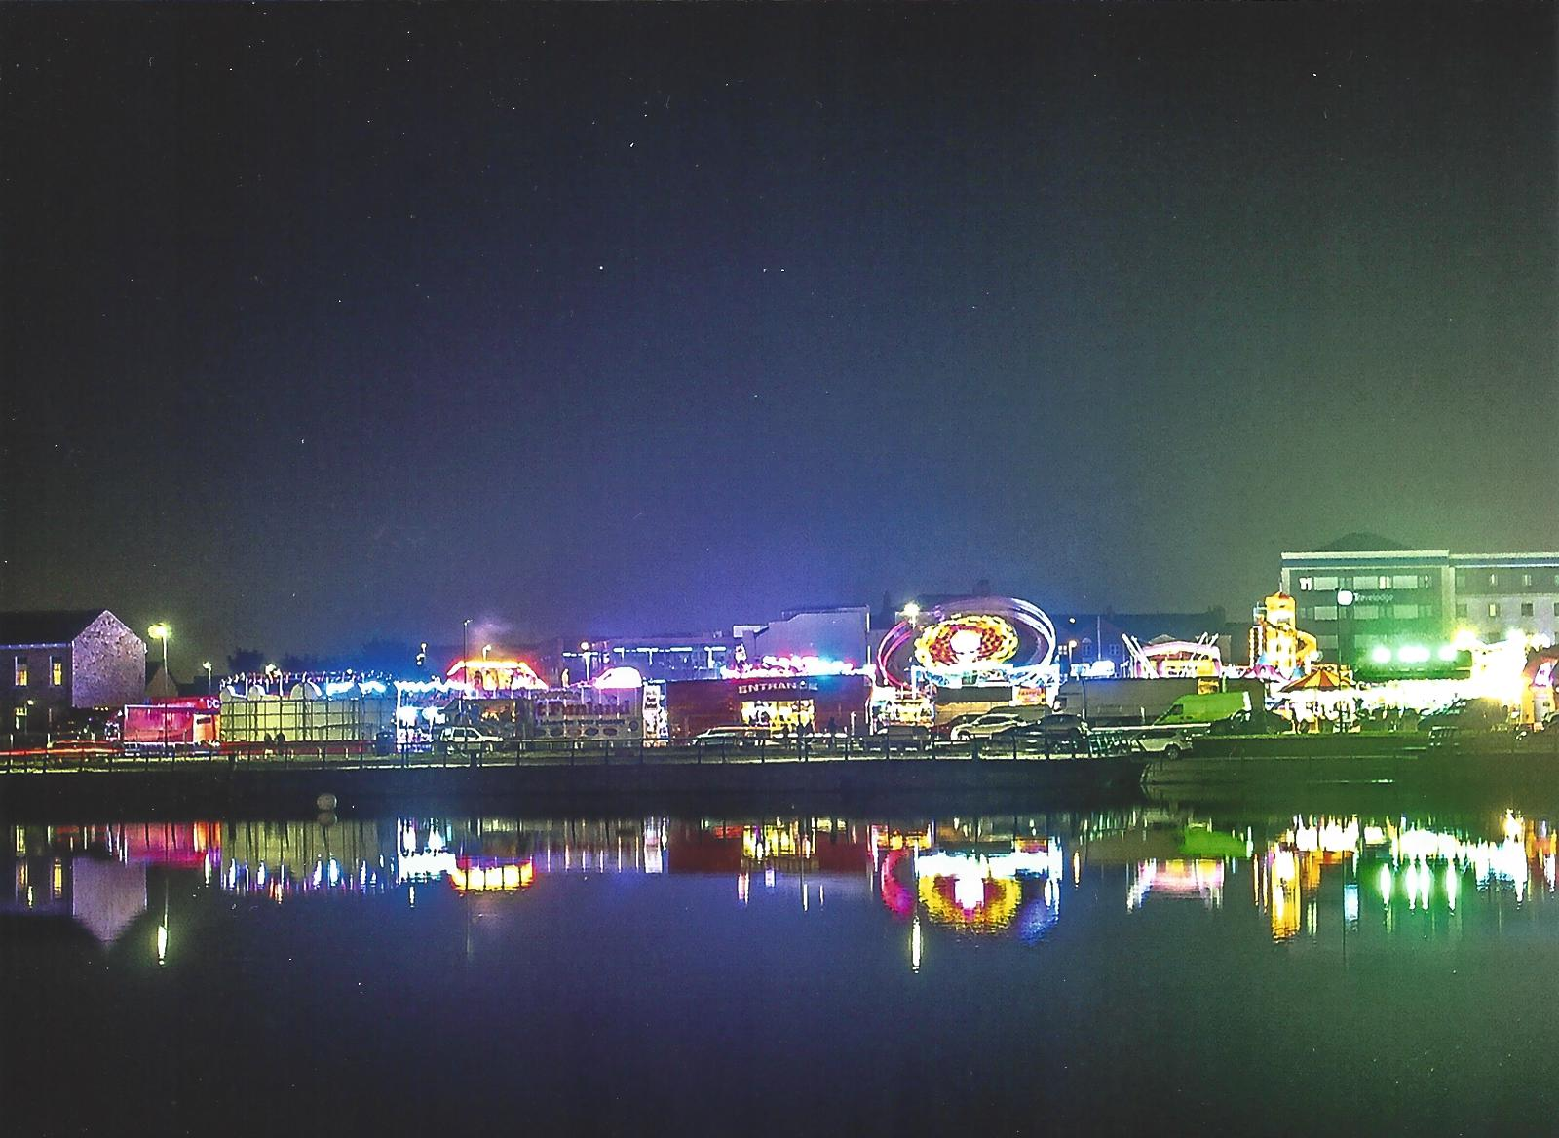

Slide 11
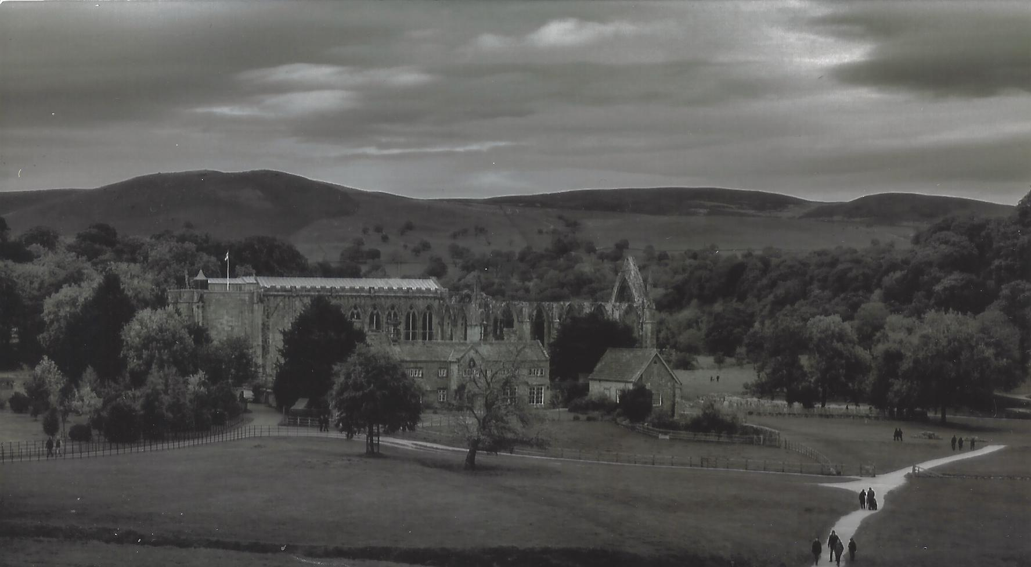

Slide 12
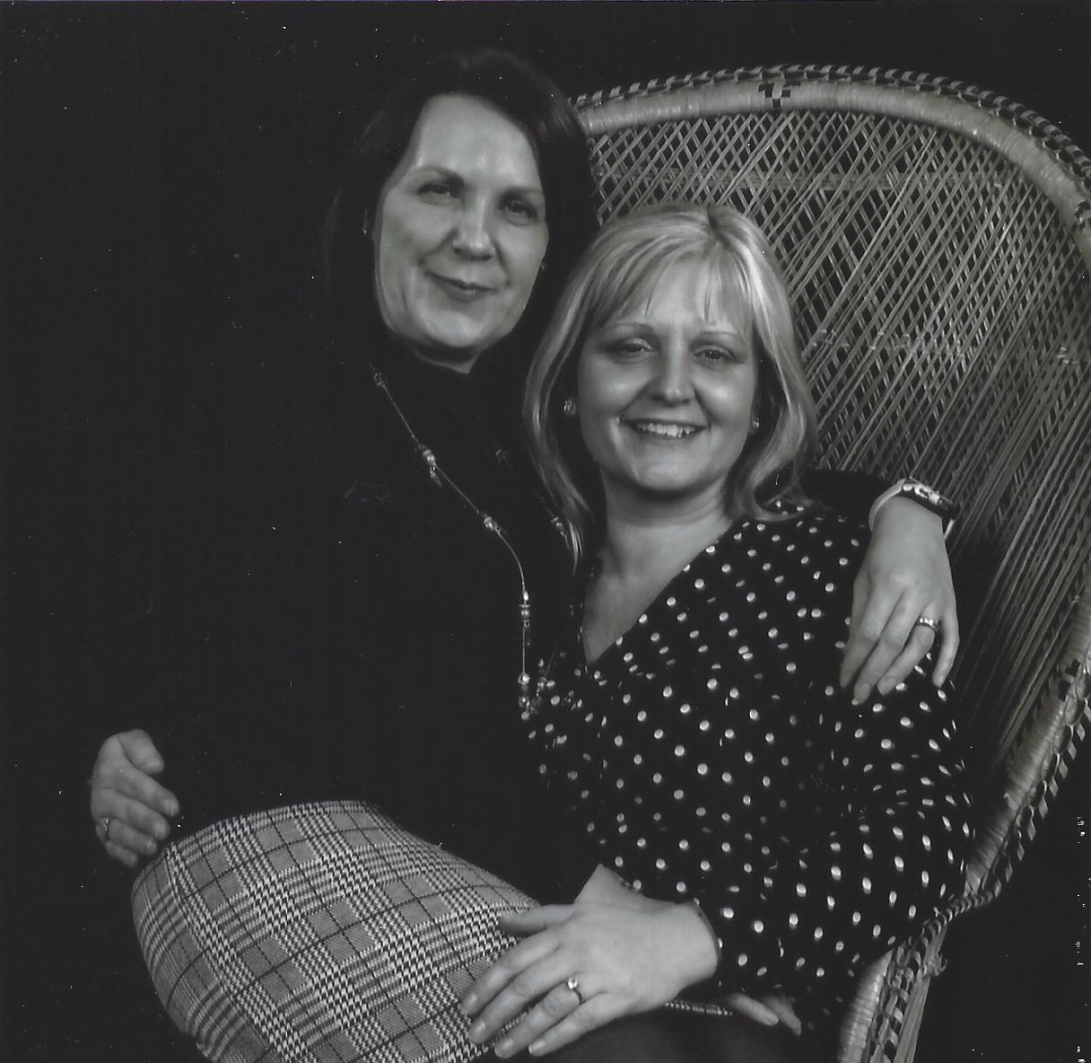

Slide 13
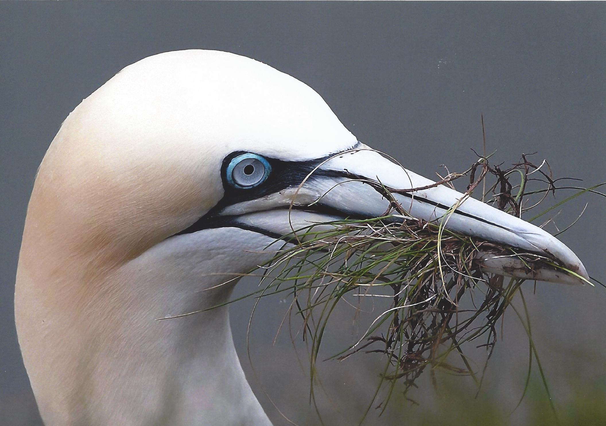

Slide 16
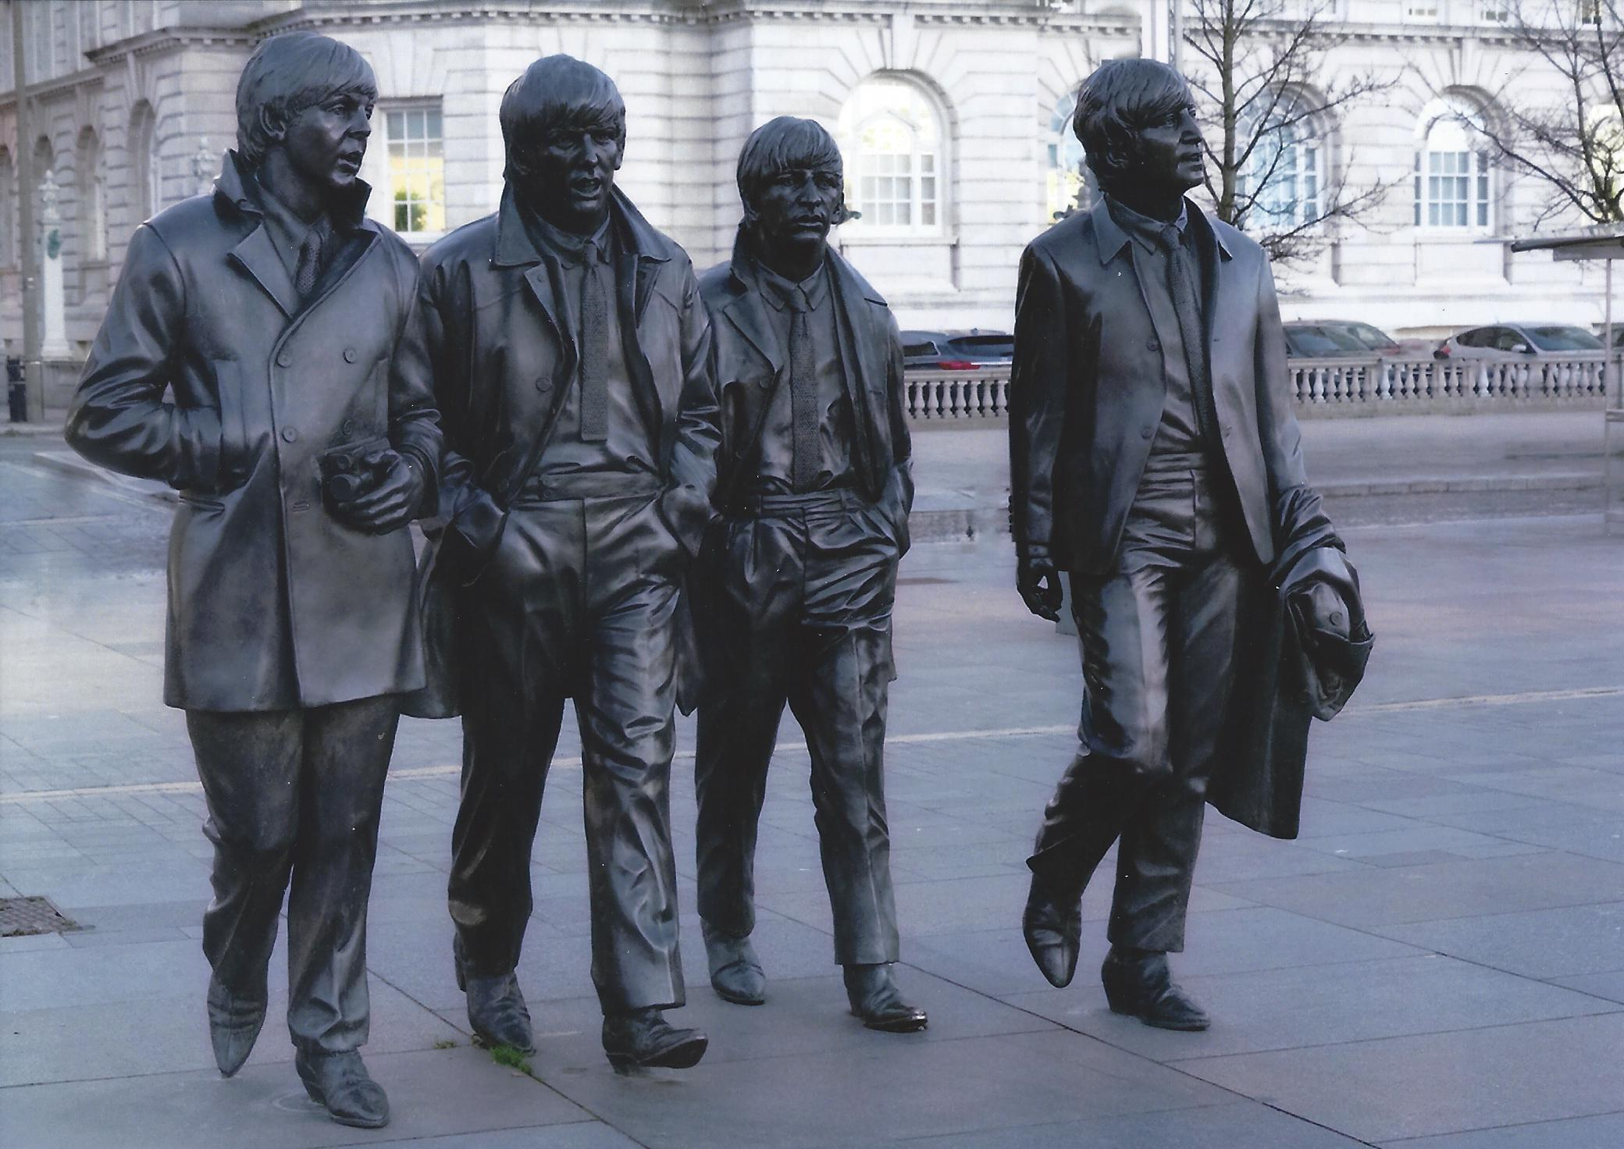

Slide 17
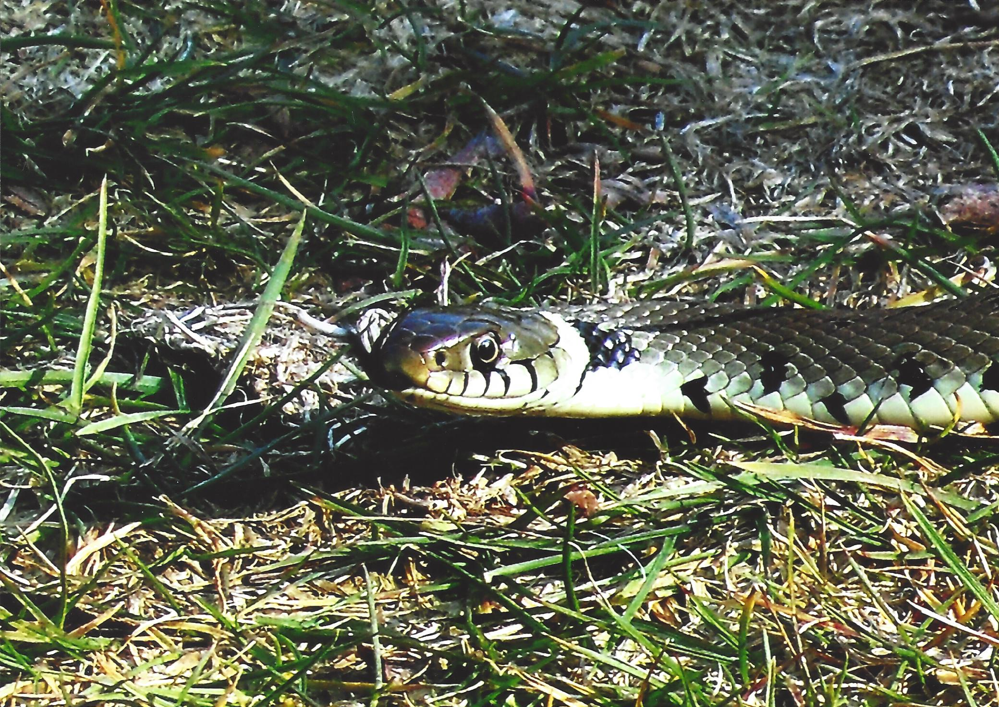

Slide 20
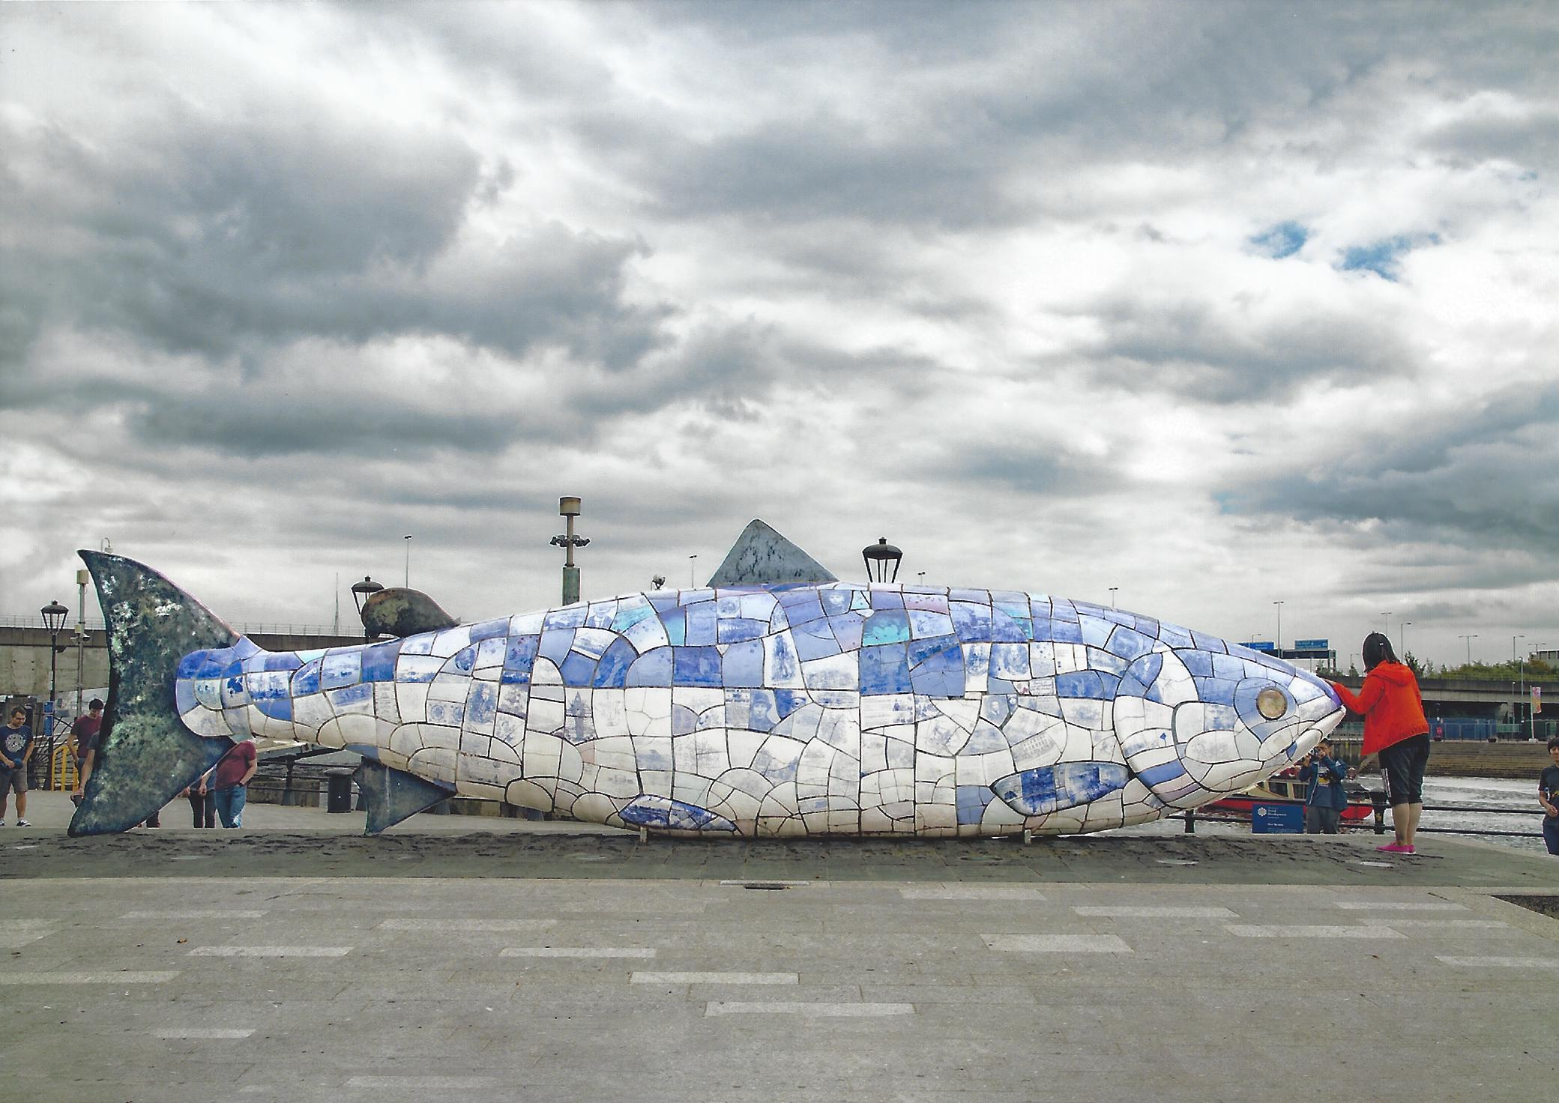

Slide 22
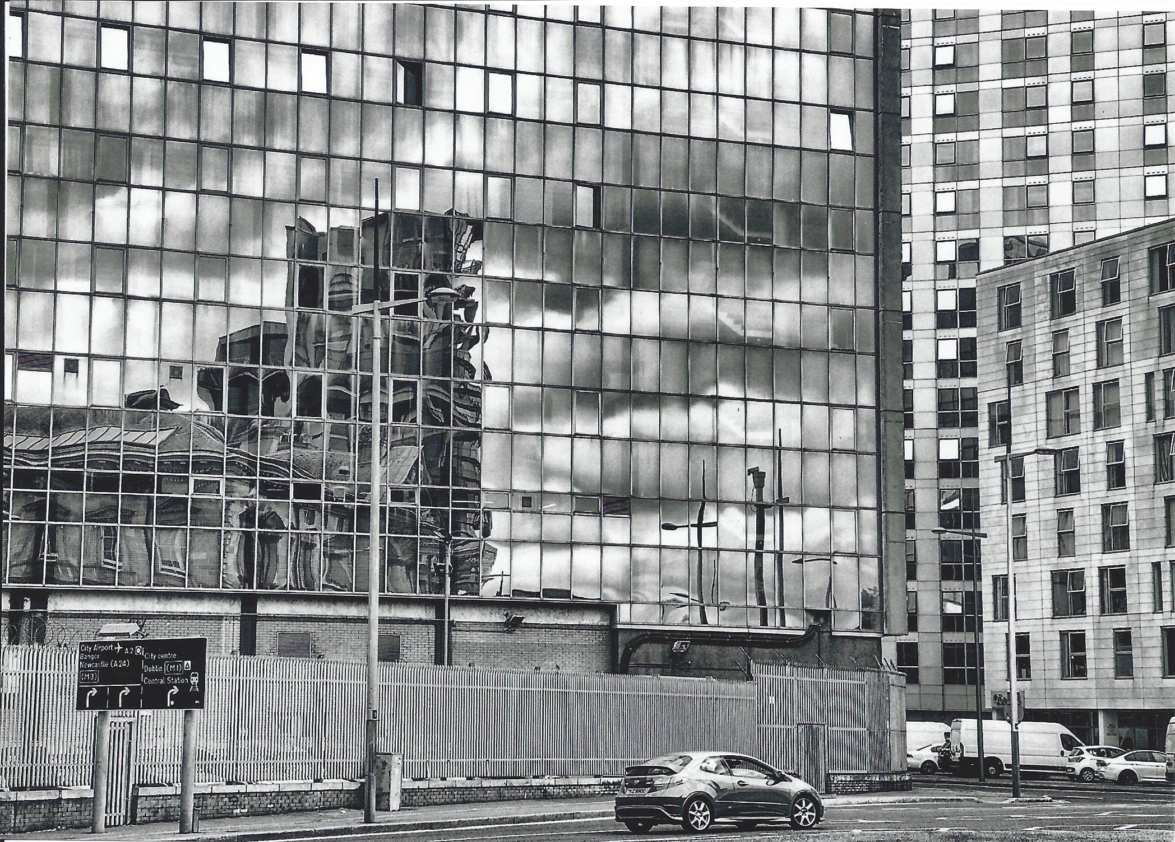

Slide 24
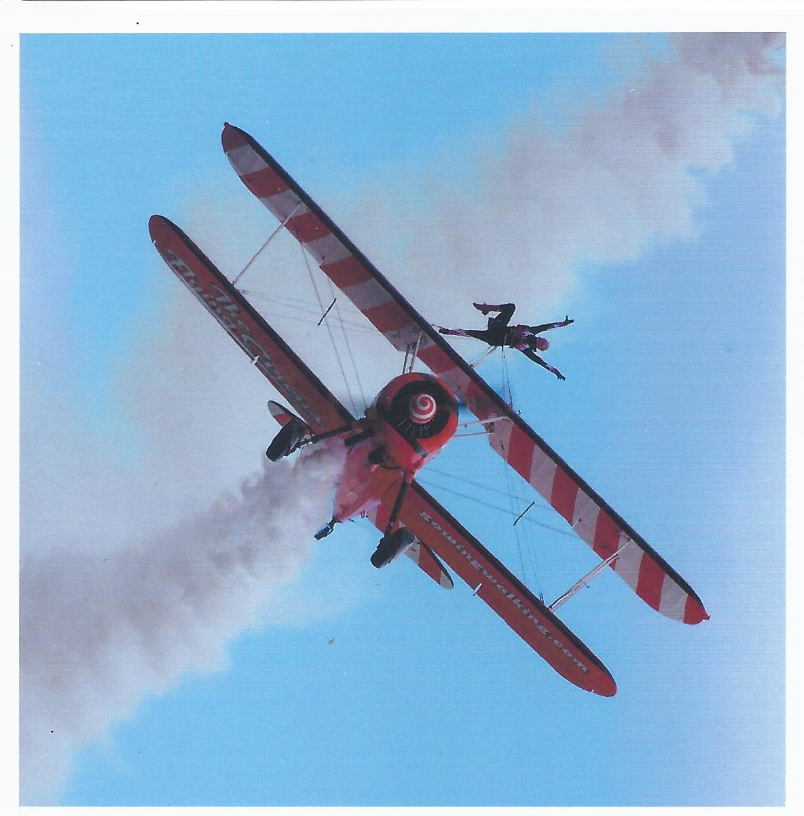

Slide 25
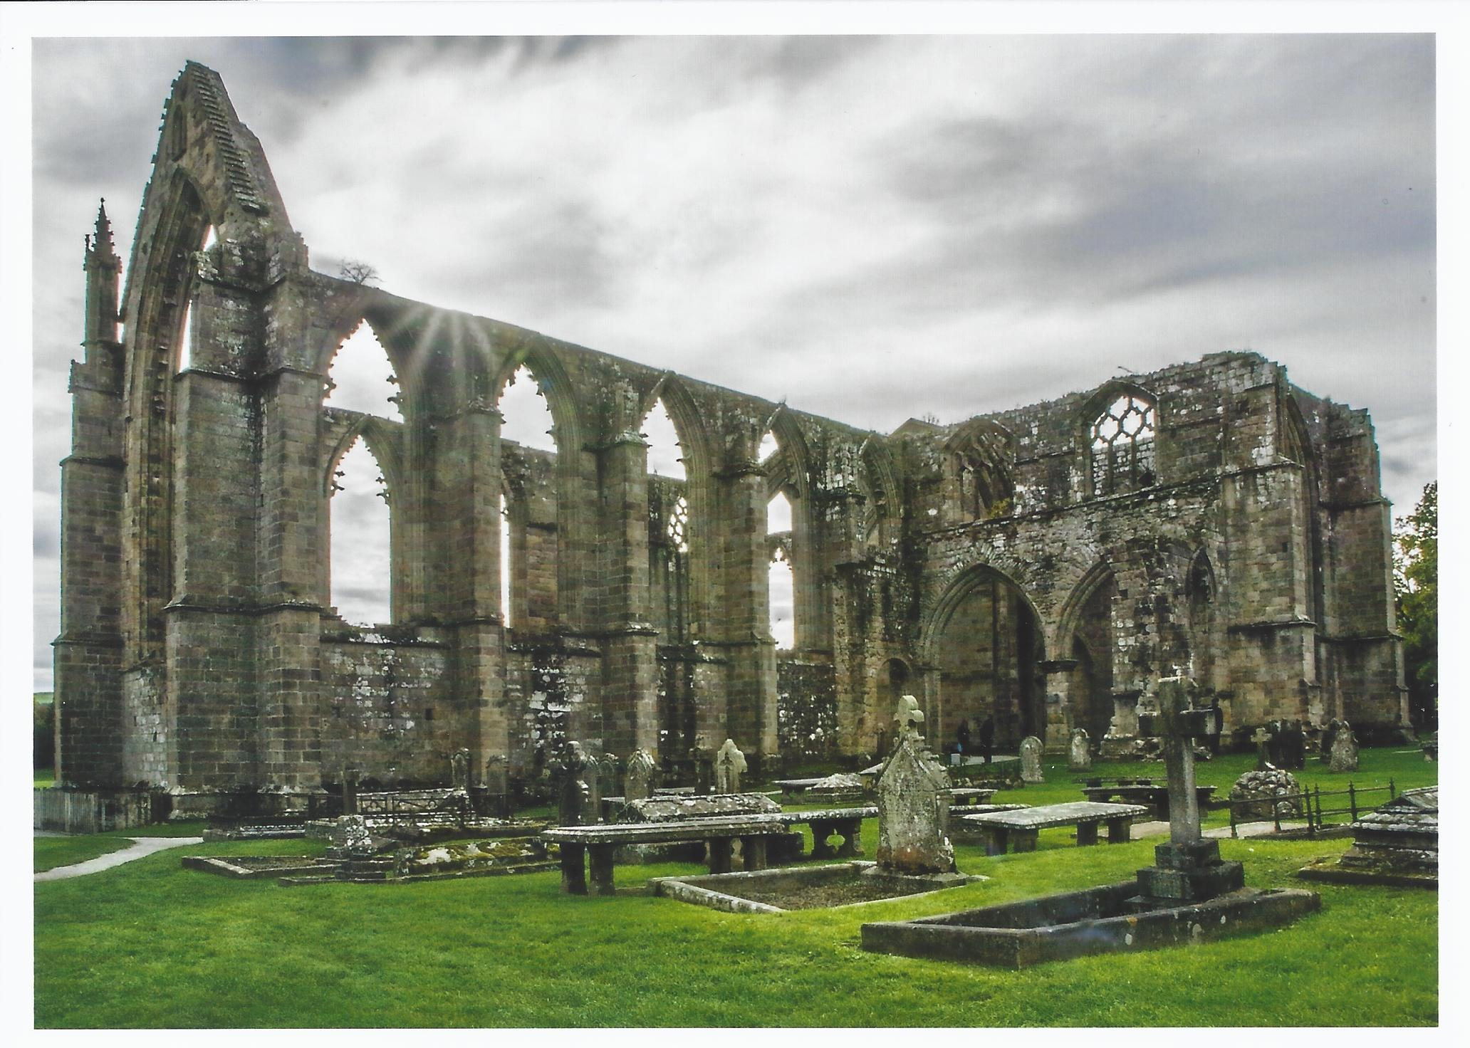

Slide 27
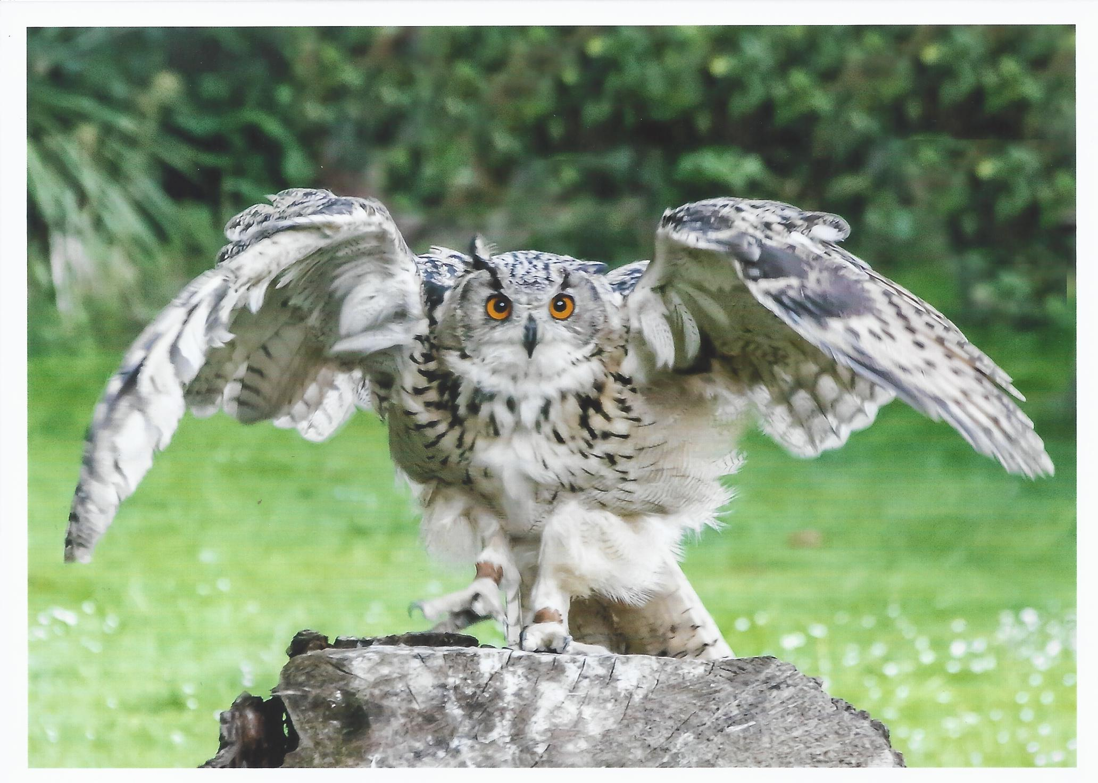

Slide 28
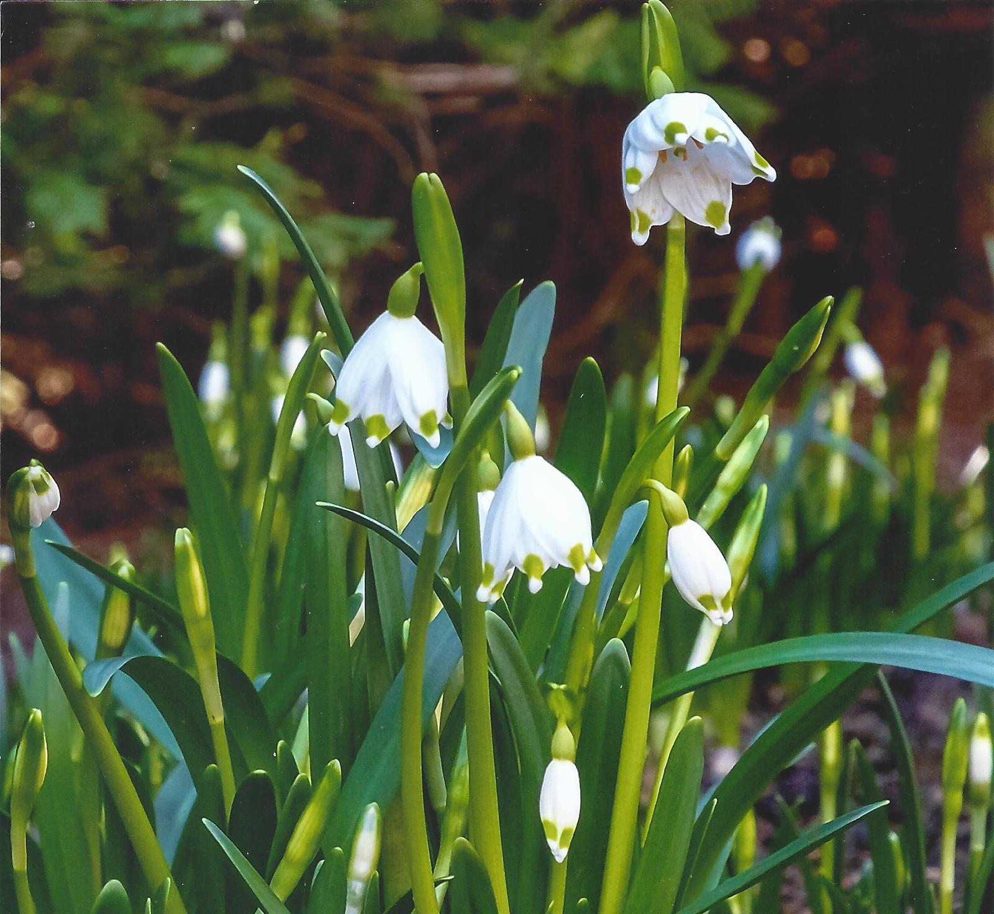

Slide 31
Manipulated Results

Slide 32
Highly Commended

Slide 33
Alan Musgrove

Slide 34
Wilf Braney

Slide 35
Steve Waller

Slide 36
Caroline Wray

Slide 37
Top Spots
From 6th Place
To
1st Place

Slide 38
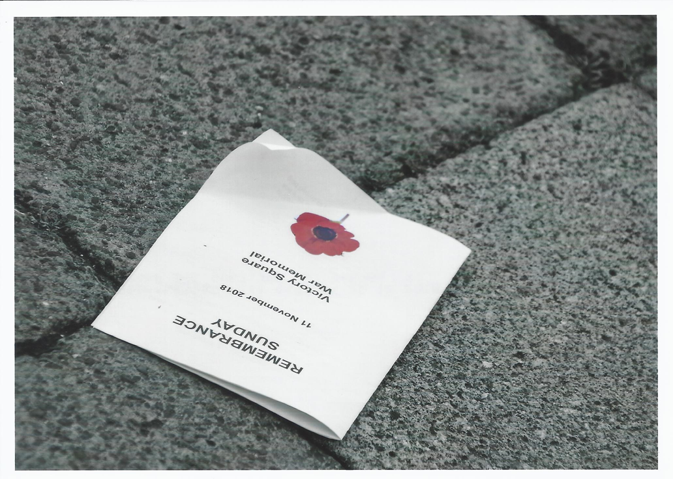
In 6th Place
Caroline Wray

Slide 39
In 5th Place
Tom Kirby

Slide 40
In 4th Place
Steve Waller

Slide 41
In 3rd Place
George Wood

Slide 42
In 2nd Place
Caroline Wray

Slide 43
In 1st Place
Steve Waller

Slide 44
March Manipulated Enprint Competition
Thank you for your attention
Next Enprint is to be held on Monday 6th April
Entries to be in 25th March
See you then

