Slide 1
HCC 2021 Enprints Competition Manipulated Entries
March 2021
Judged By
Phillip Yuill

Slide 2
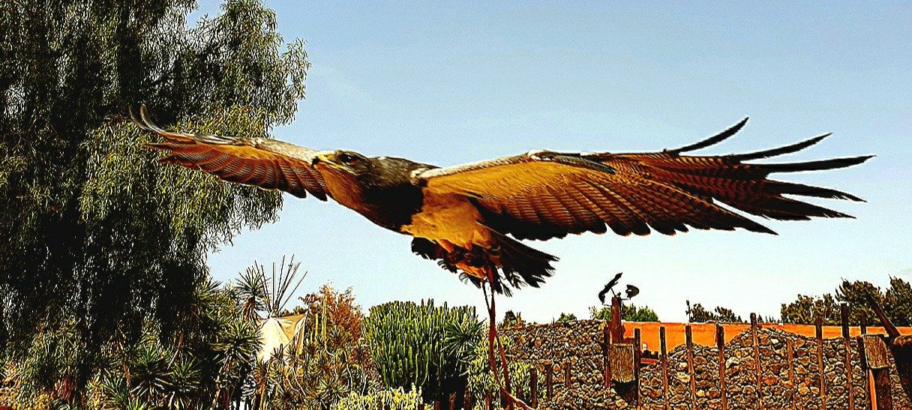

Slide 3
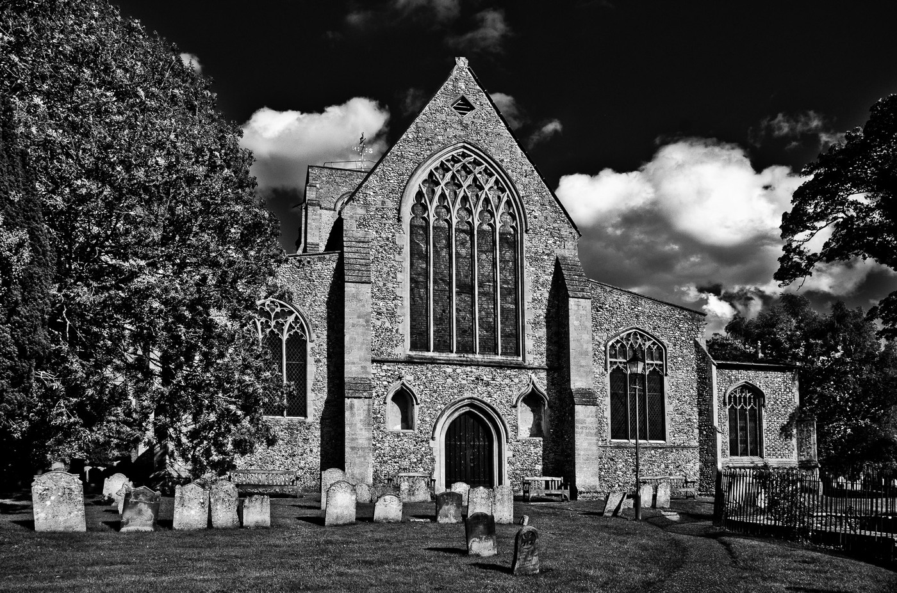

Slide 5
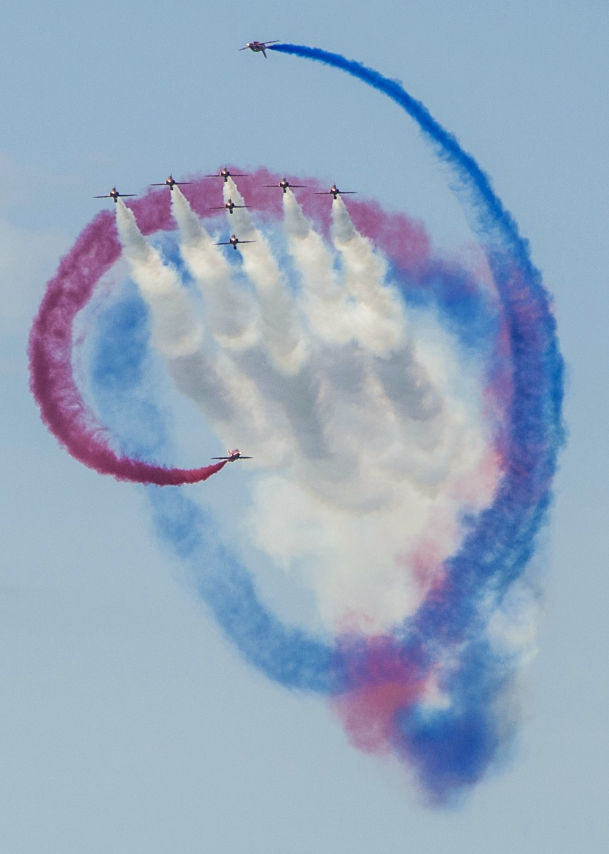

Slide 9
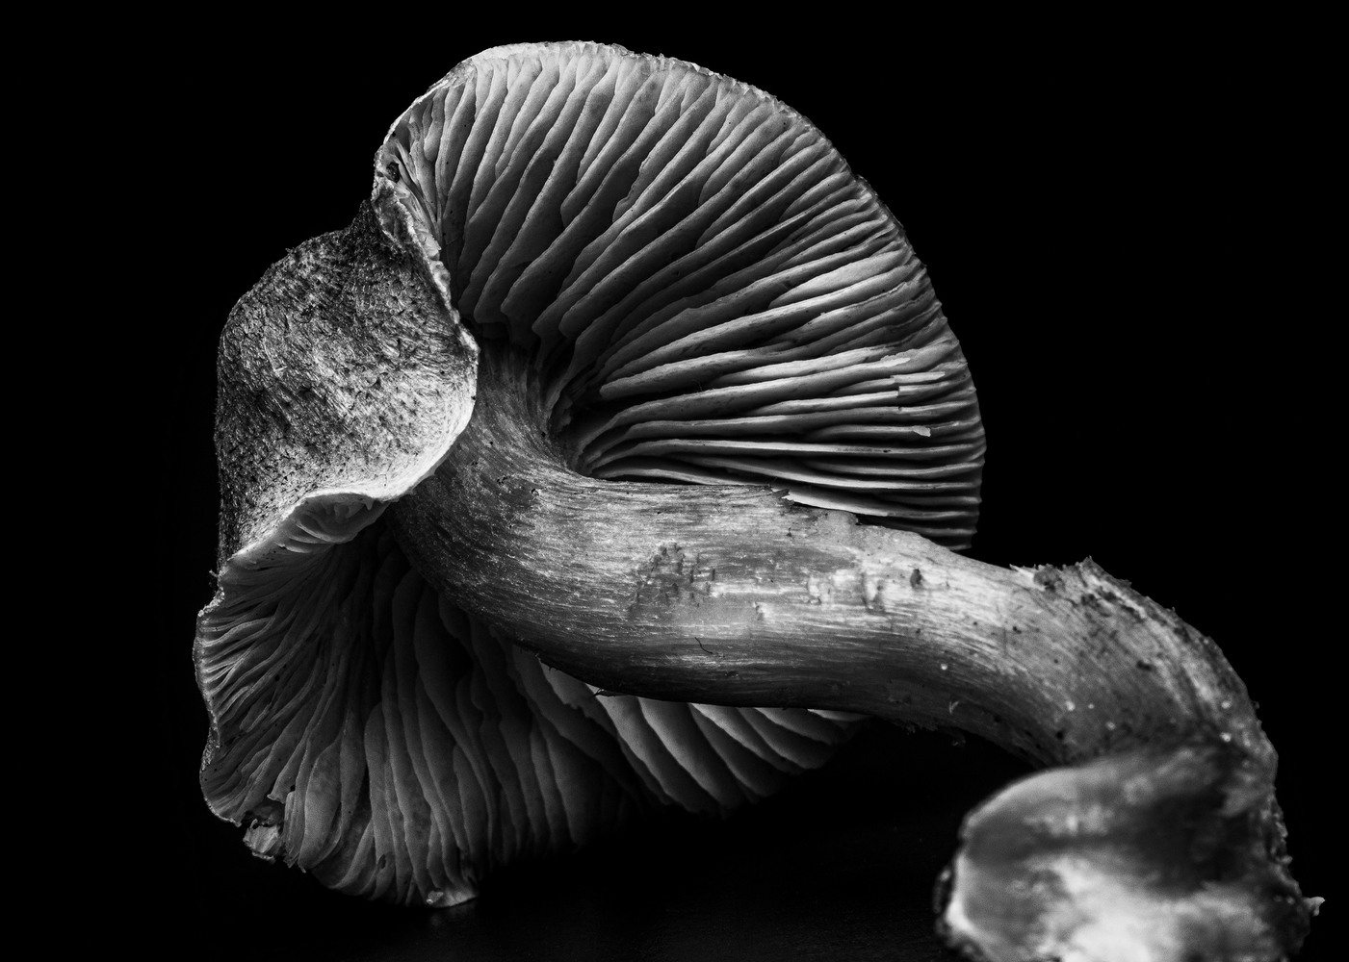

Slide 10
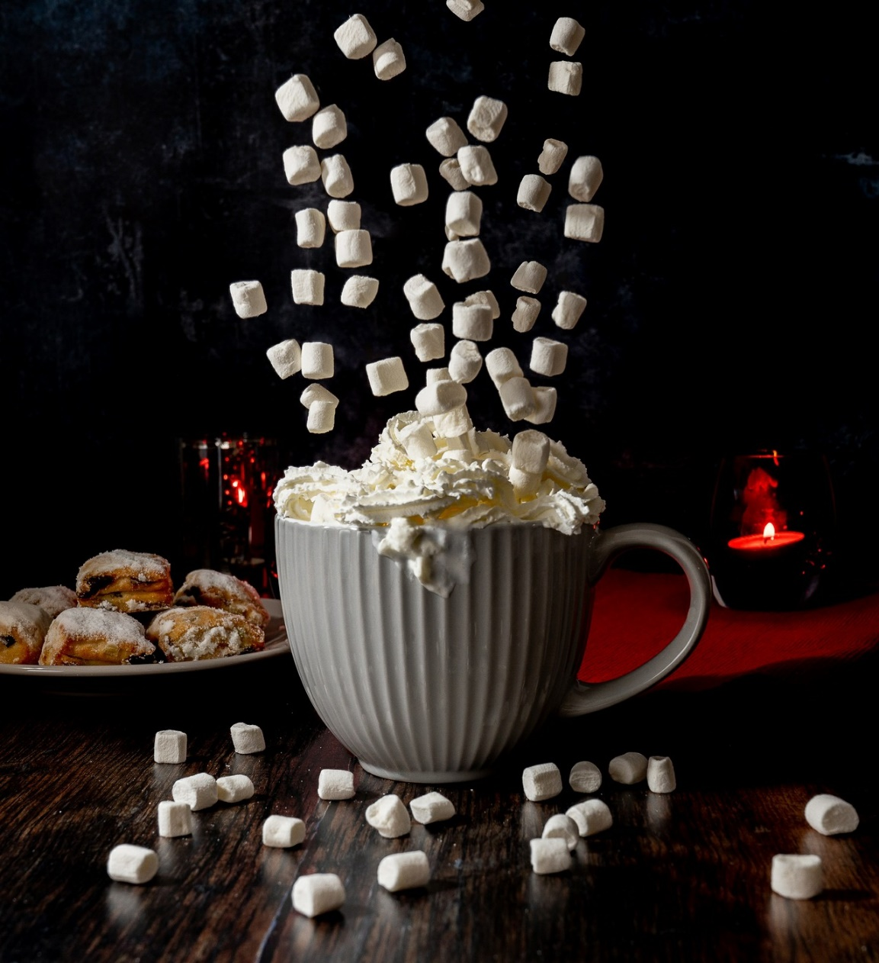

Slide 11
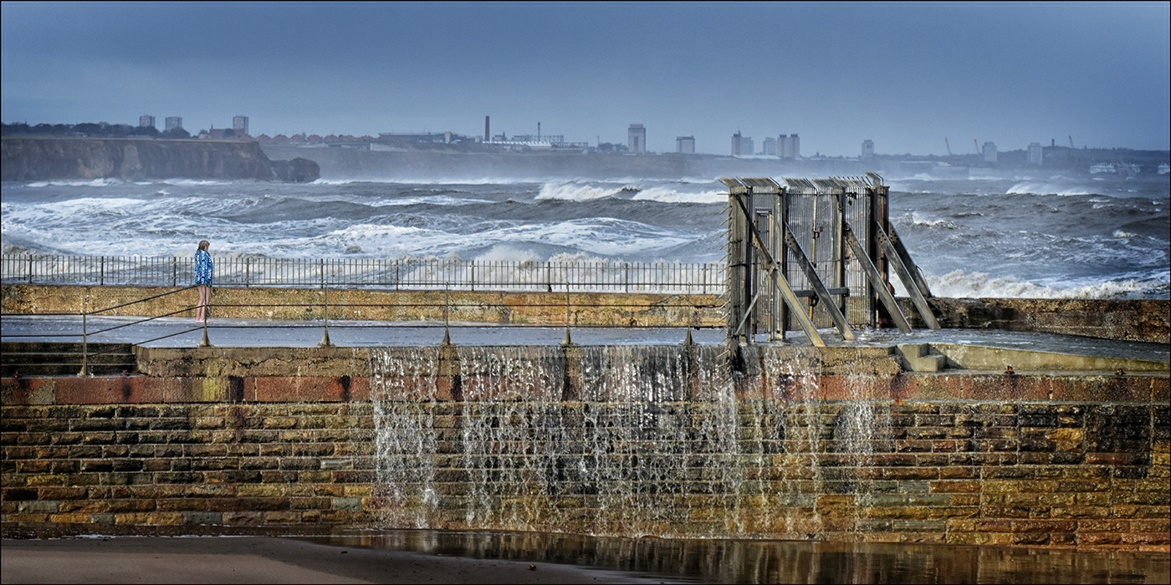

Slide 12
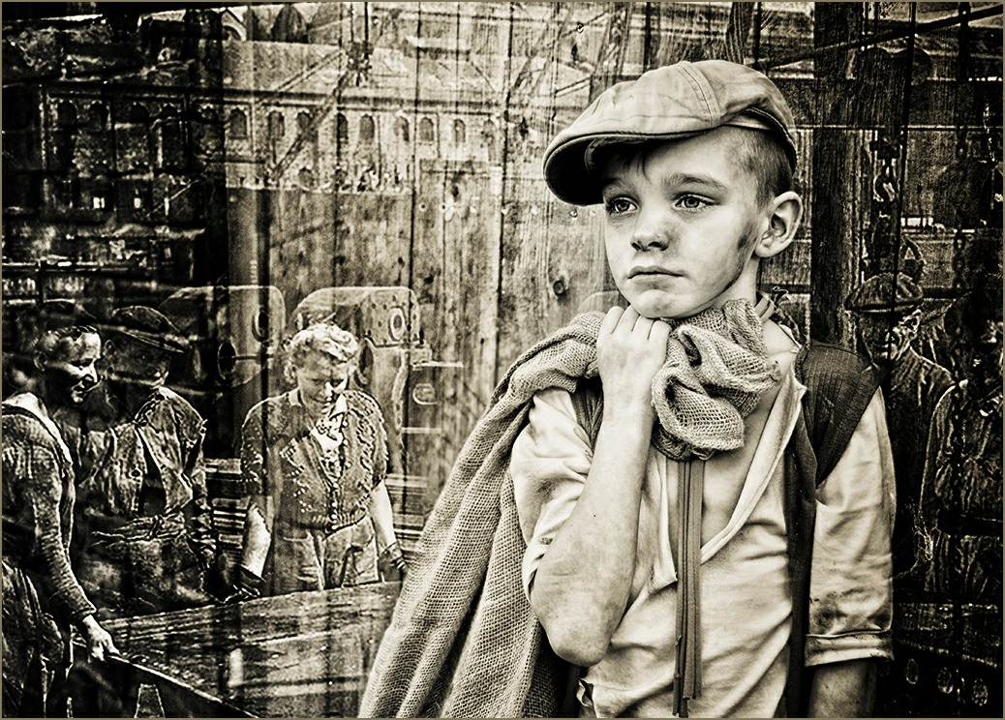

Slide 13
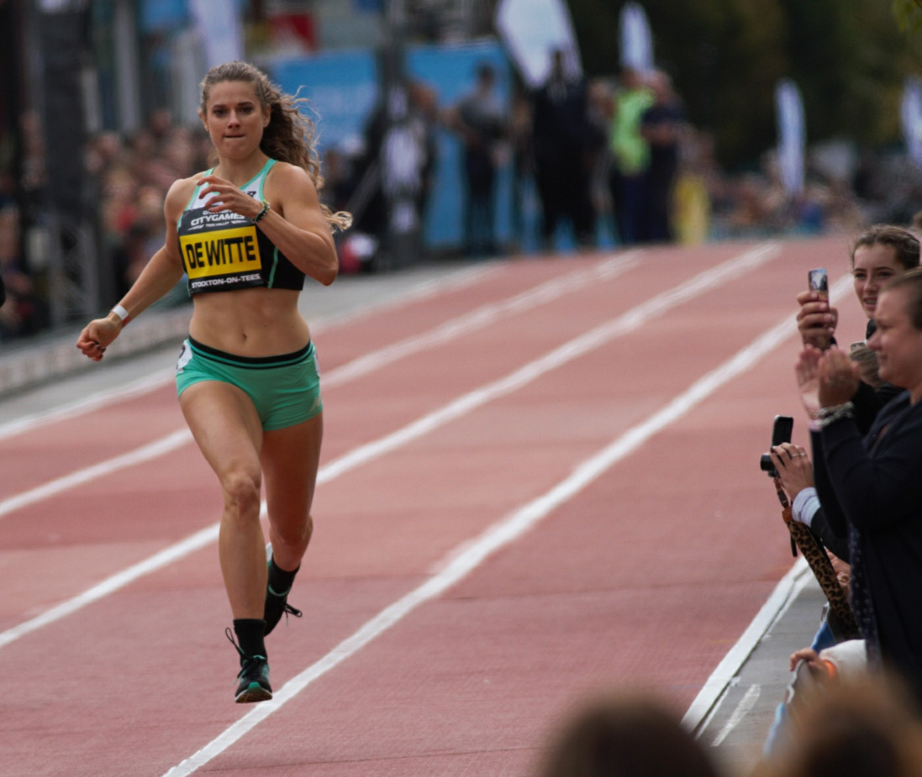

Slide 15
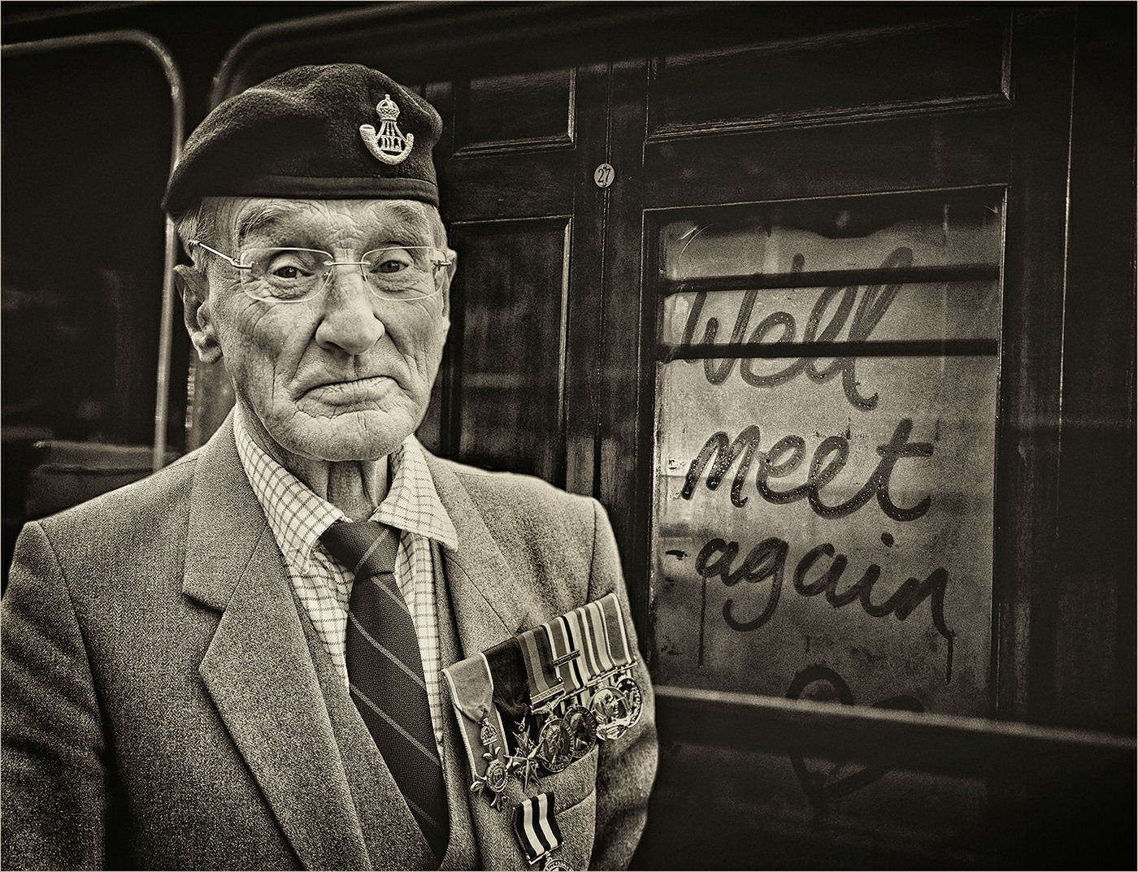

Slide 16
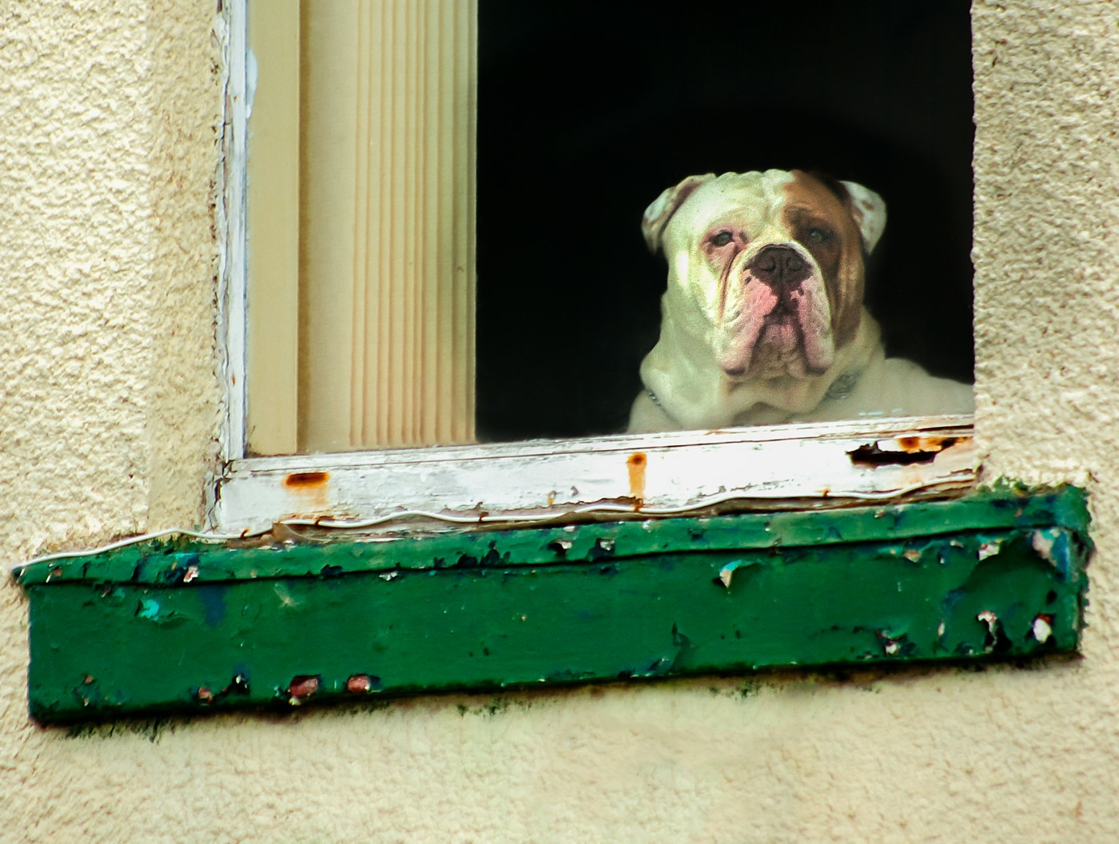

Slide 17
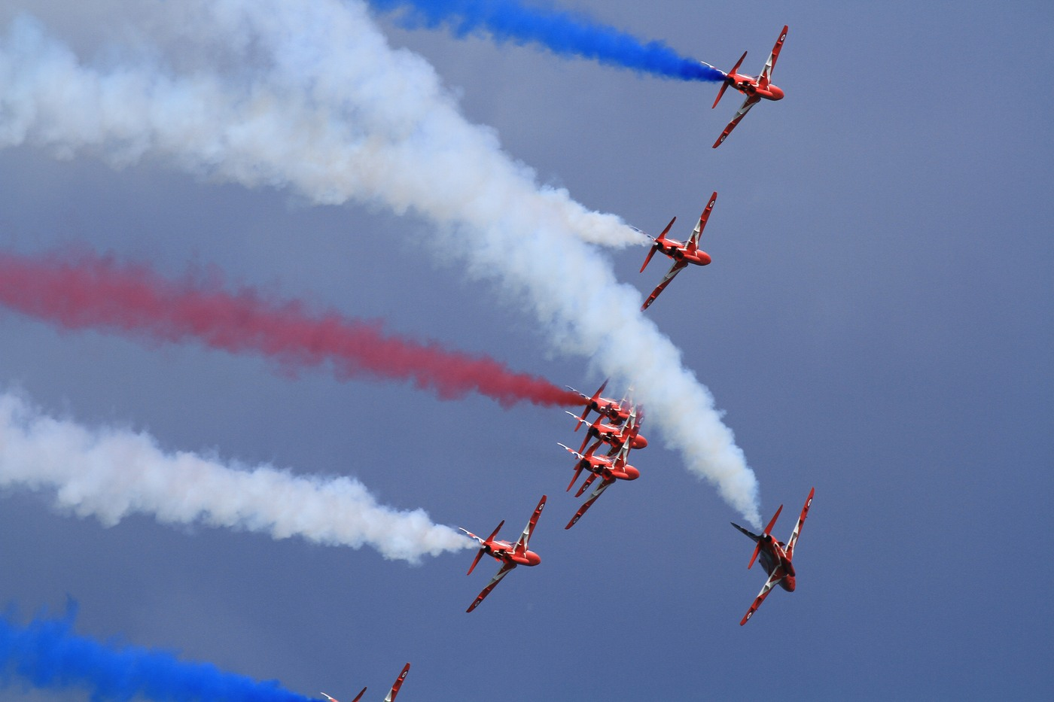

Slide 19
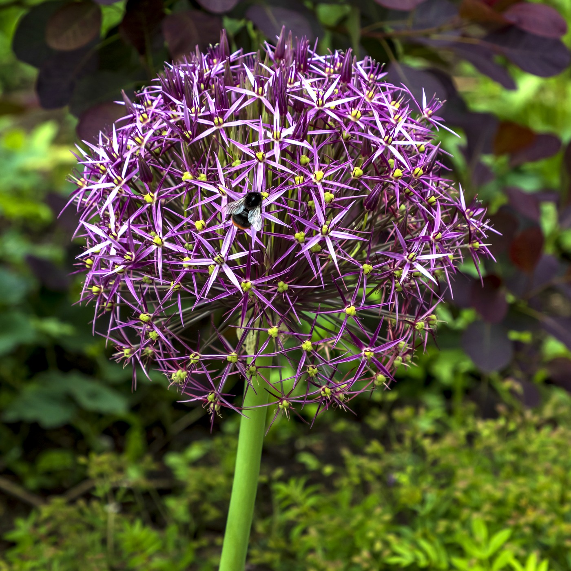

Slide 22
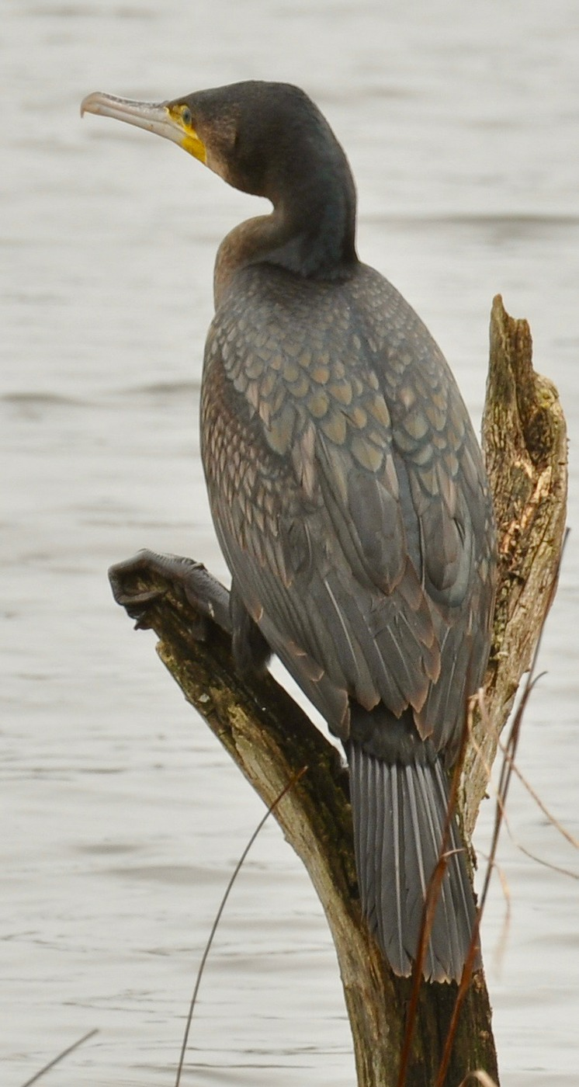

Slide 23
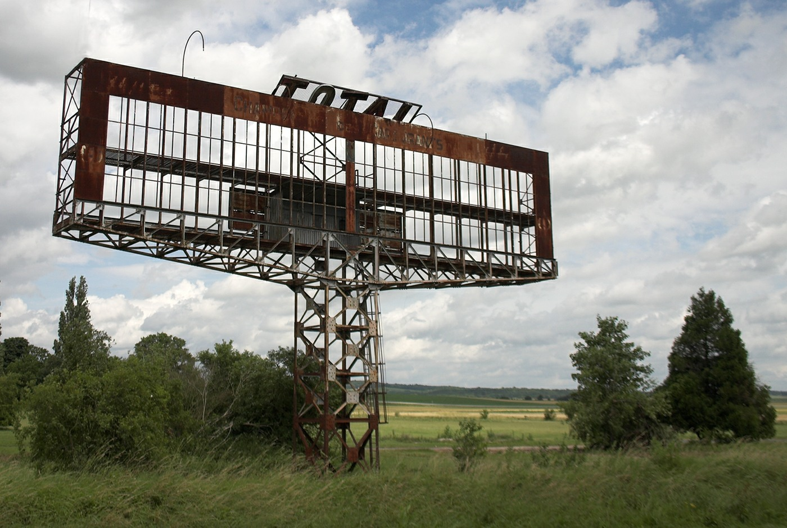

Slide 24
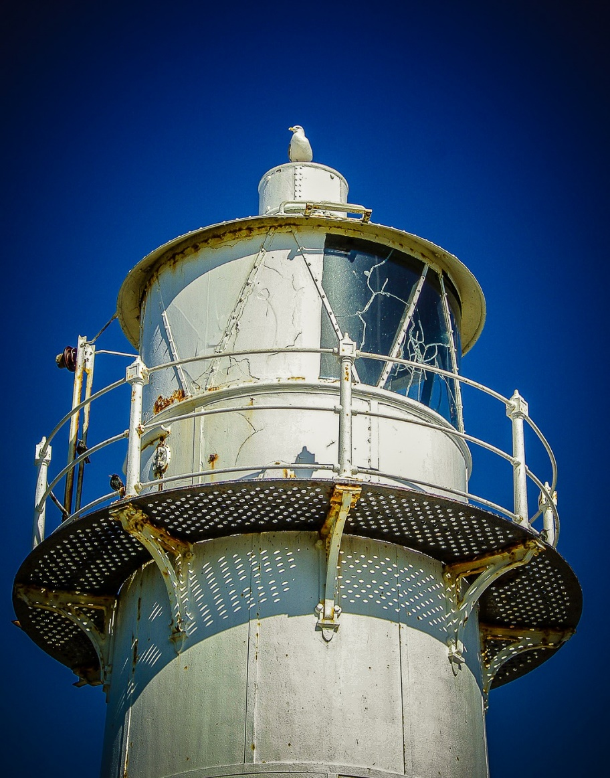

Slide 27
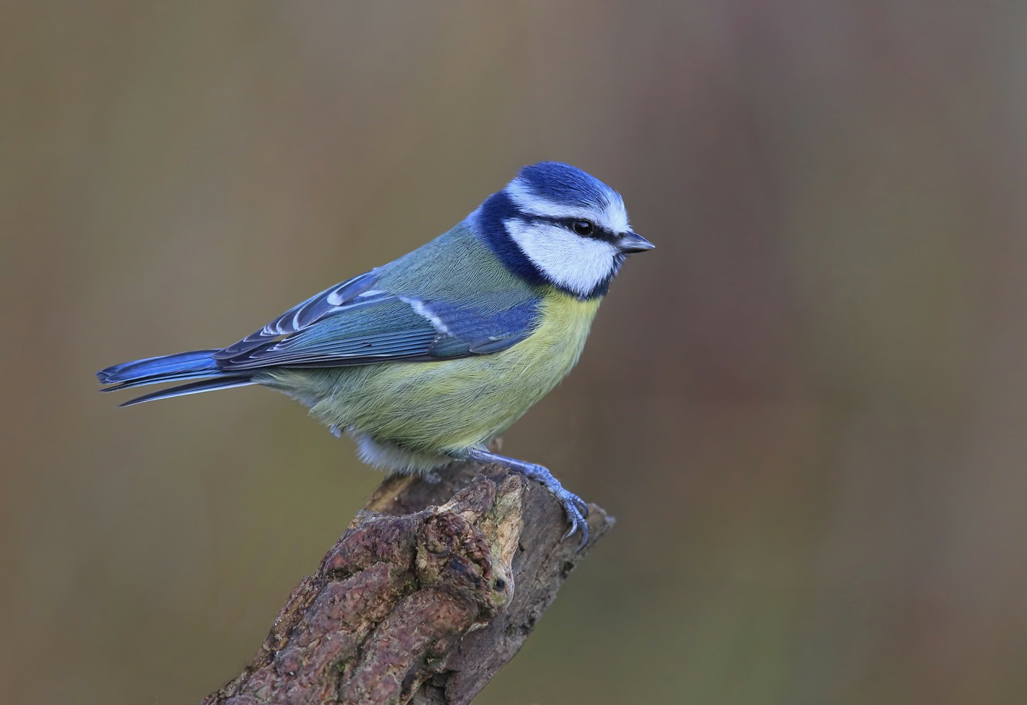

Slide 29
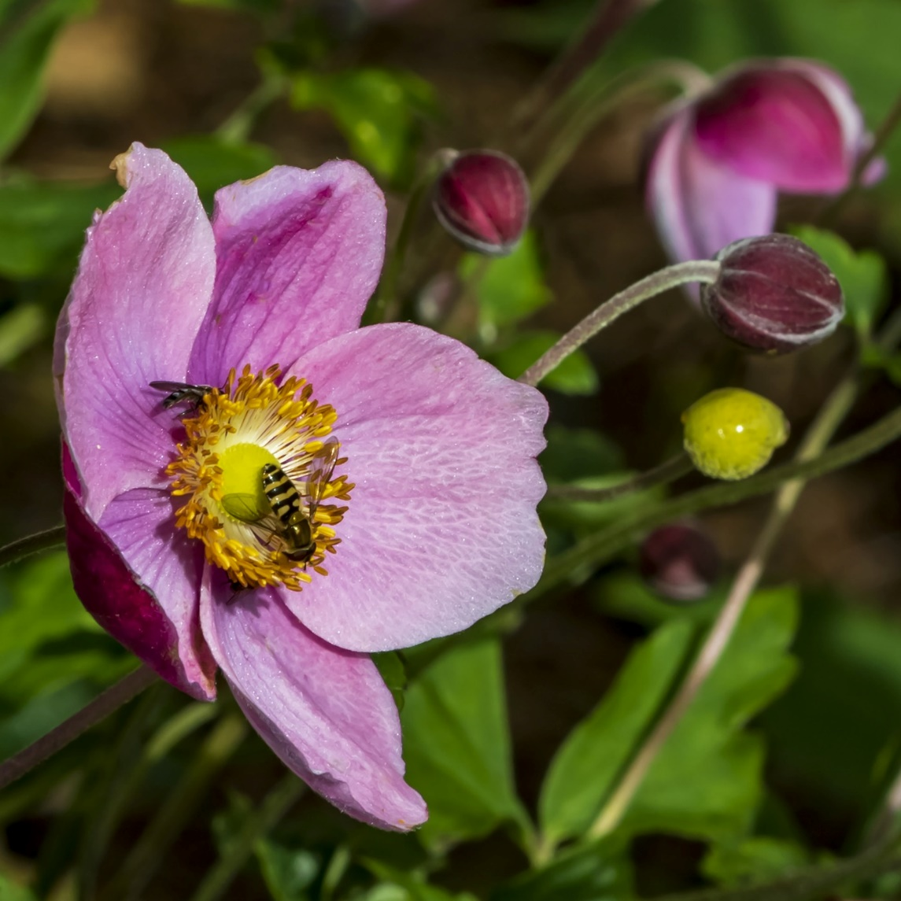

Slide 32
Manipulated Results

Slide 33
Highly Commended

Slide 34
Phil Kilburn

Slide 35
Caroline Wray

Slide 36
Harry Brenkley

Slide 37
Kathryn Waites

Slide 38
Phil Kilburn

Slide 39
Alan Musgrove

Slide 40
Top Spots
From 6th Place
To
1st Place

Slide 41
6th Place
Harry Brenkley

Slide 42
5th Place
Angy Ellis

Slide 43
4th Place
Bev Trainer

Slide 44
3rd Place
Bev Trainer

Slide 45
2nd Place
Angy Ellis

Slide 46
1st Place
David Kay

Slide 47
March Unmanipulated Enprint Competition
Thank you for your attention

