Slide 1
HCC Enprints Competition Unmanipulated Entries
March 2019
Judged By
Brendan Magennis

Slide 2
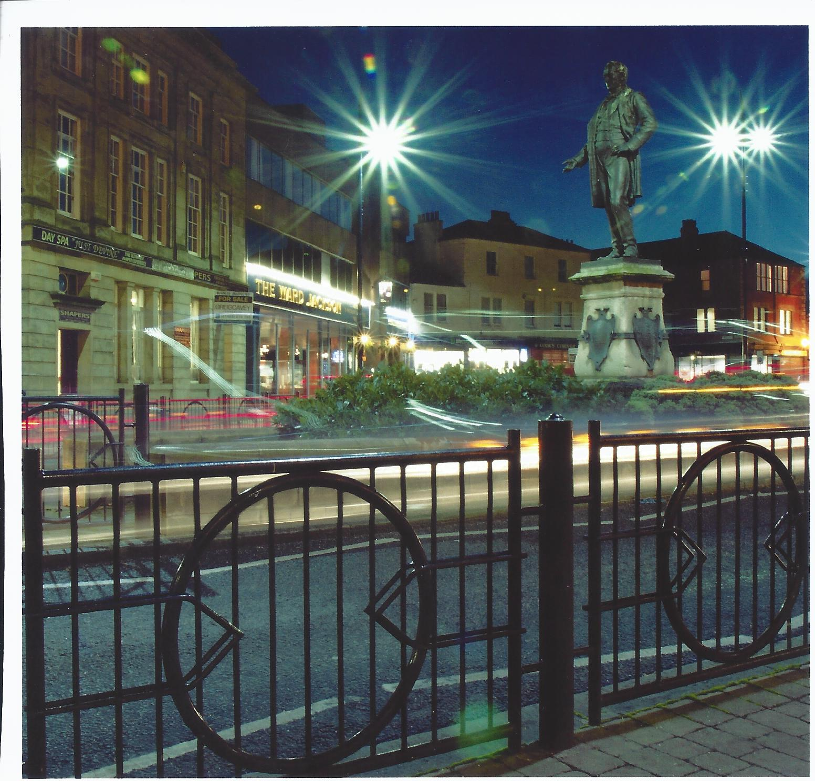

Slide 3
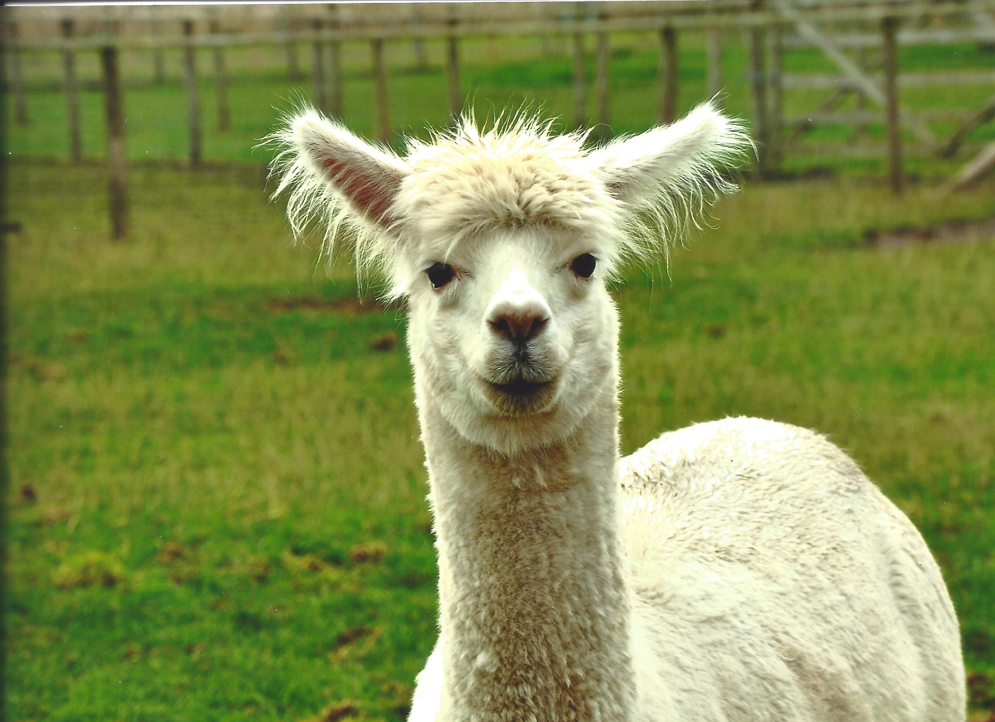

Slide 6
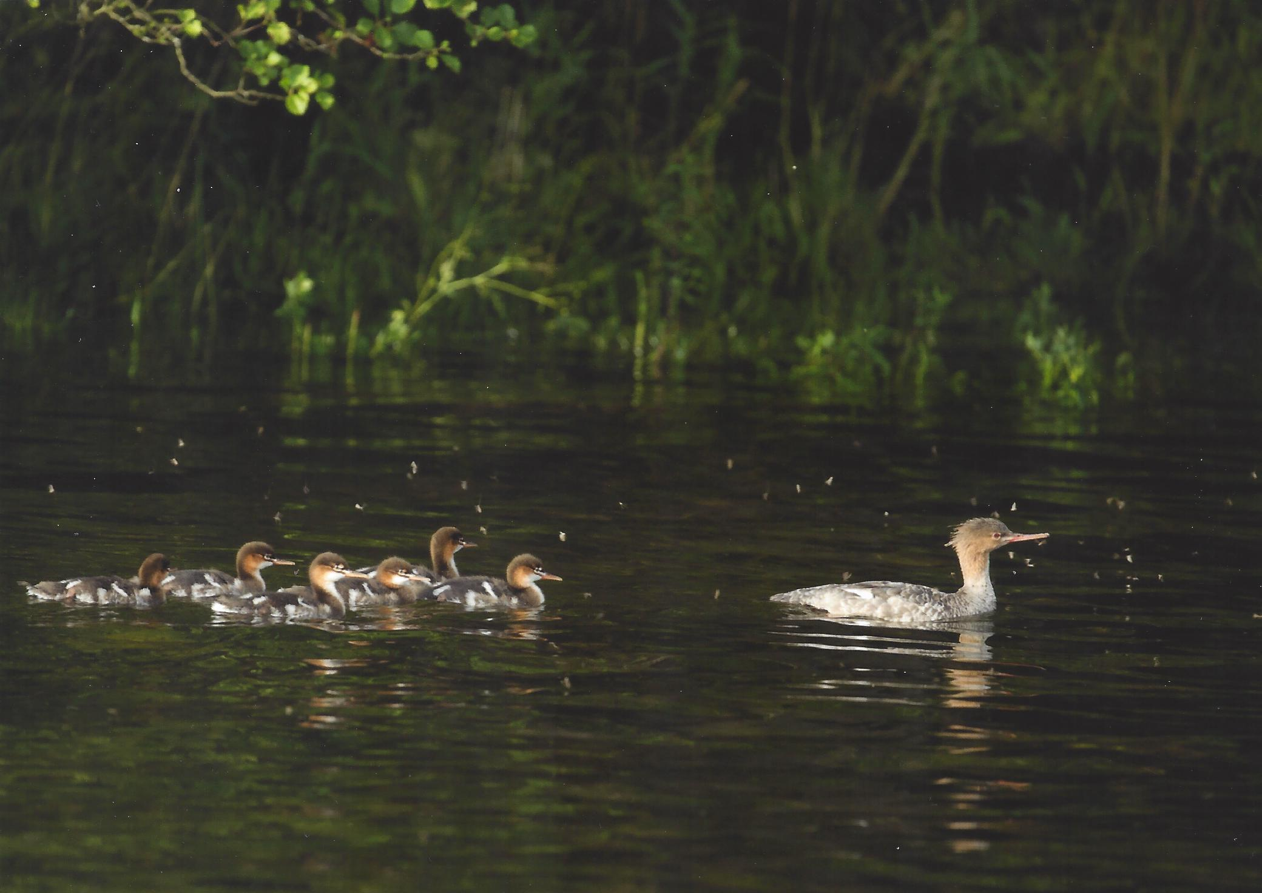

Slide 8
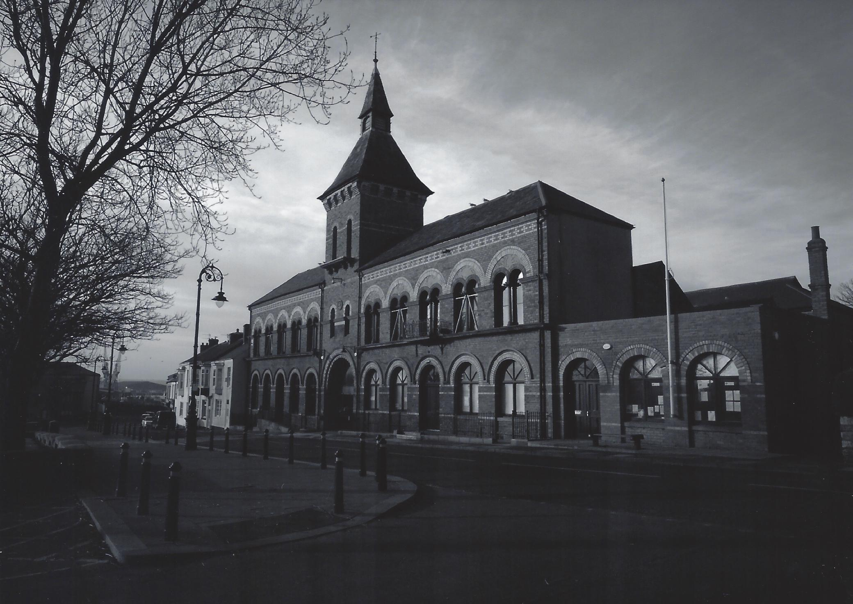

Slide 9
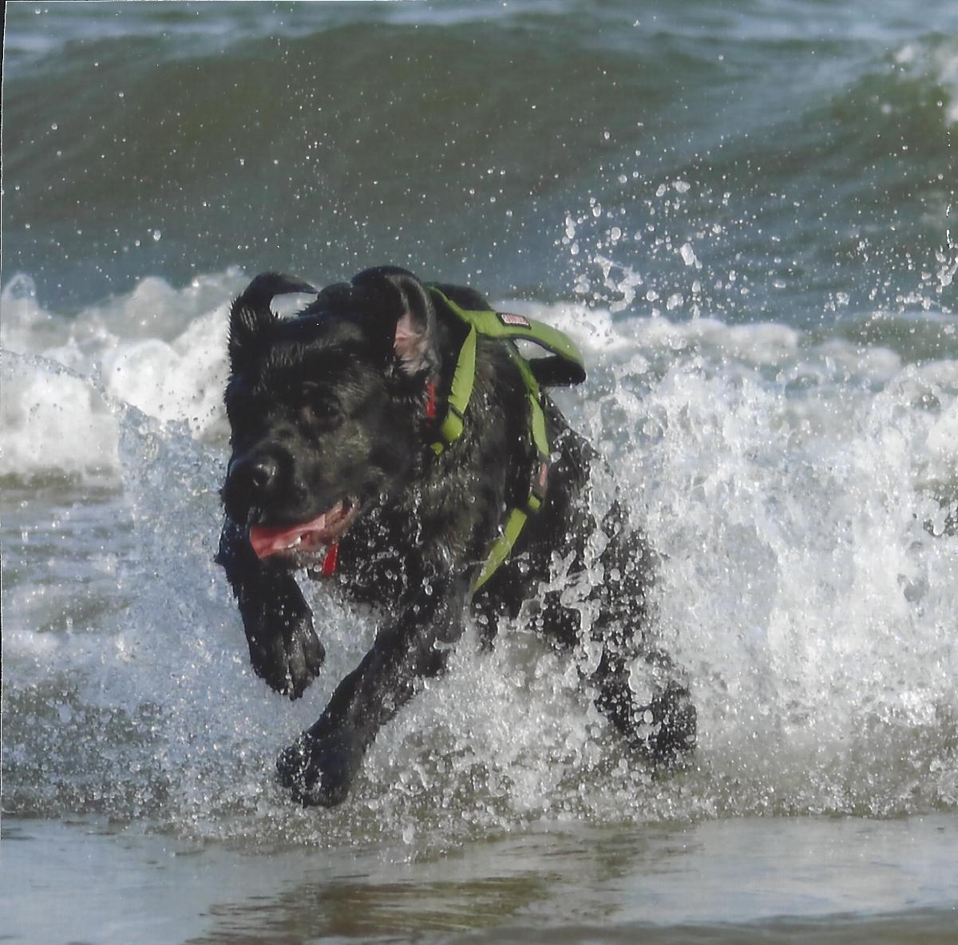

Slide 10
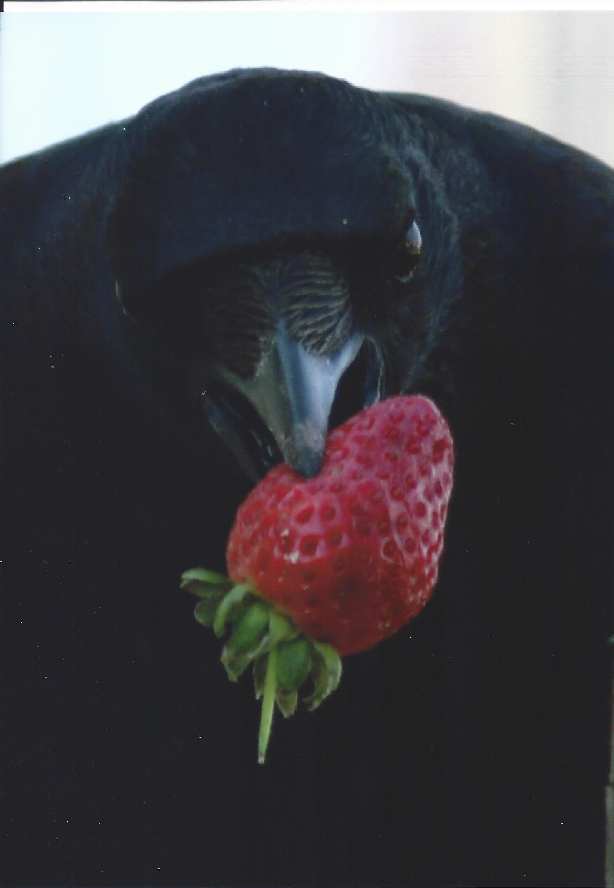

Slide 11
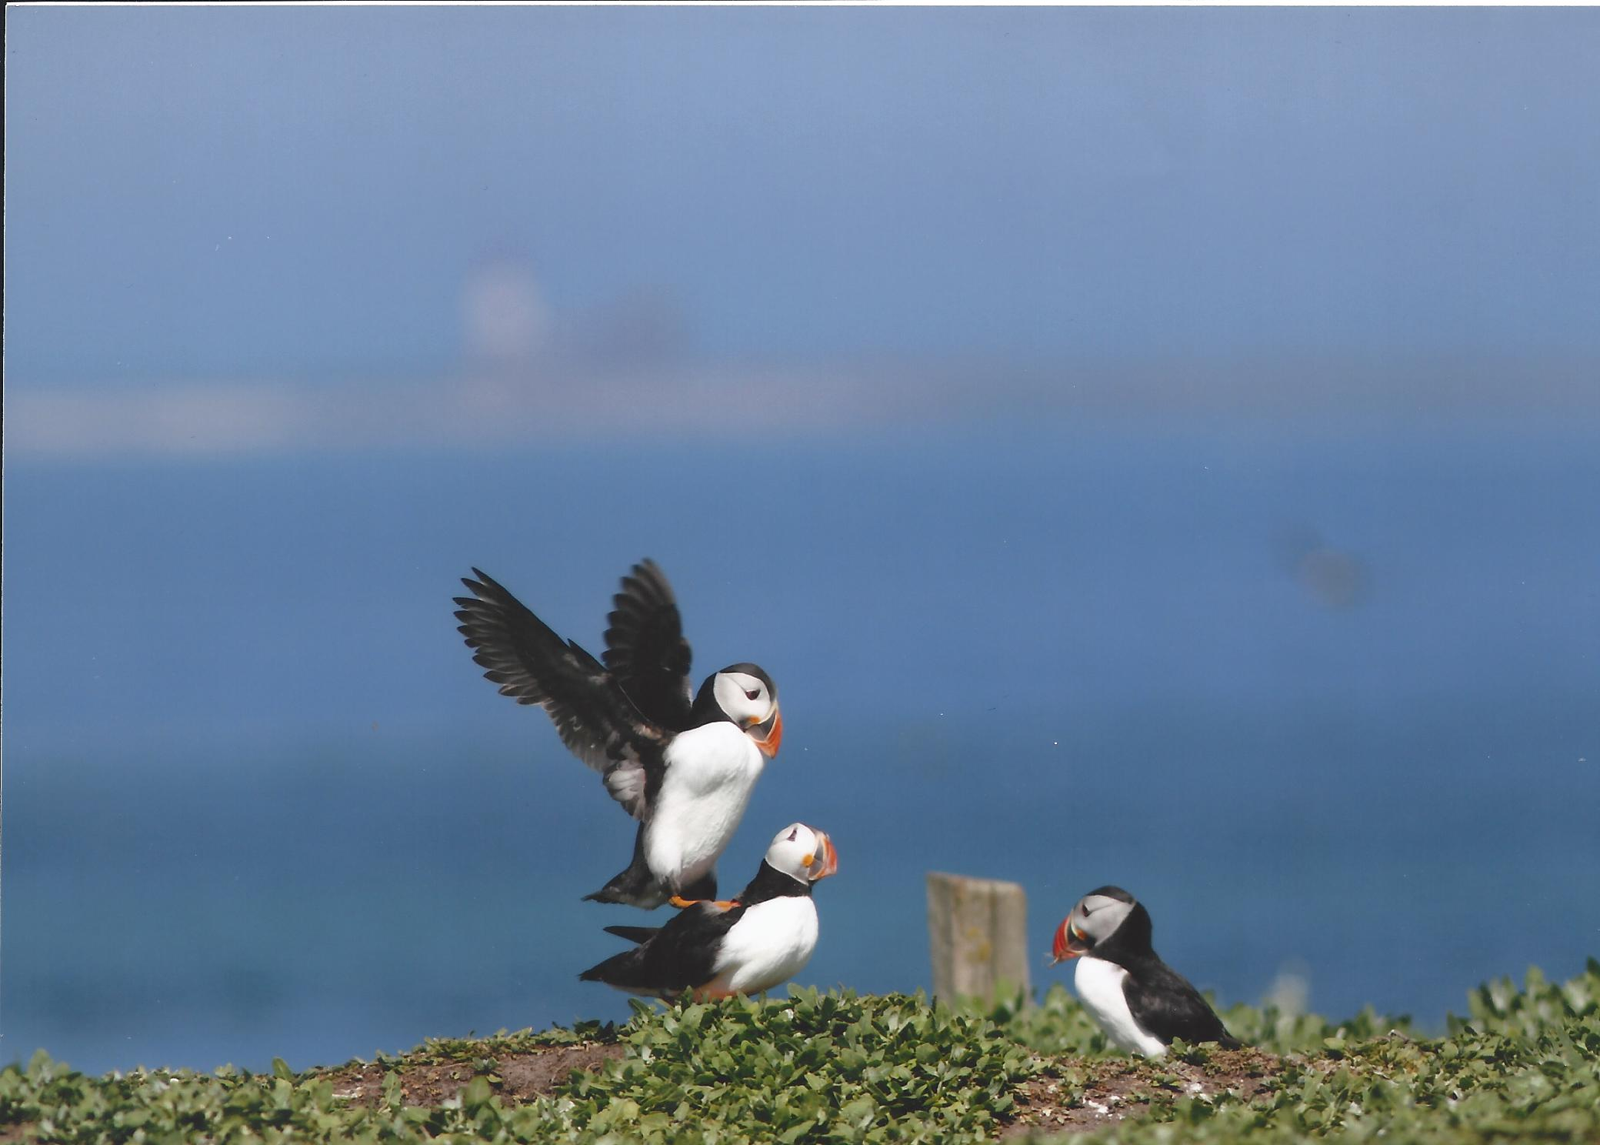

Slide 13
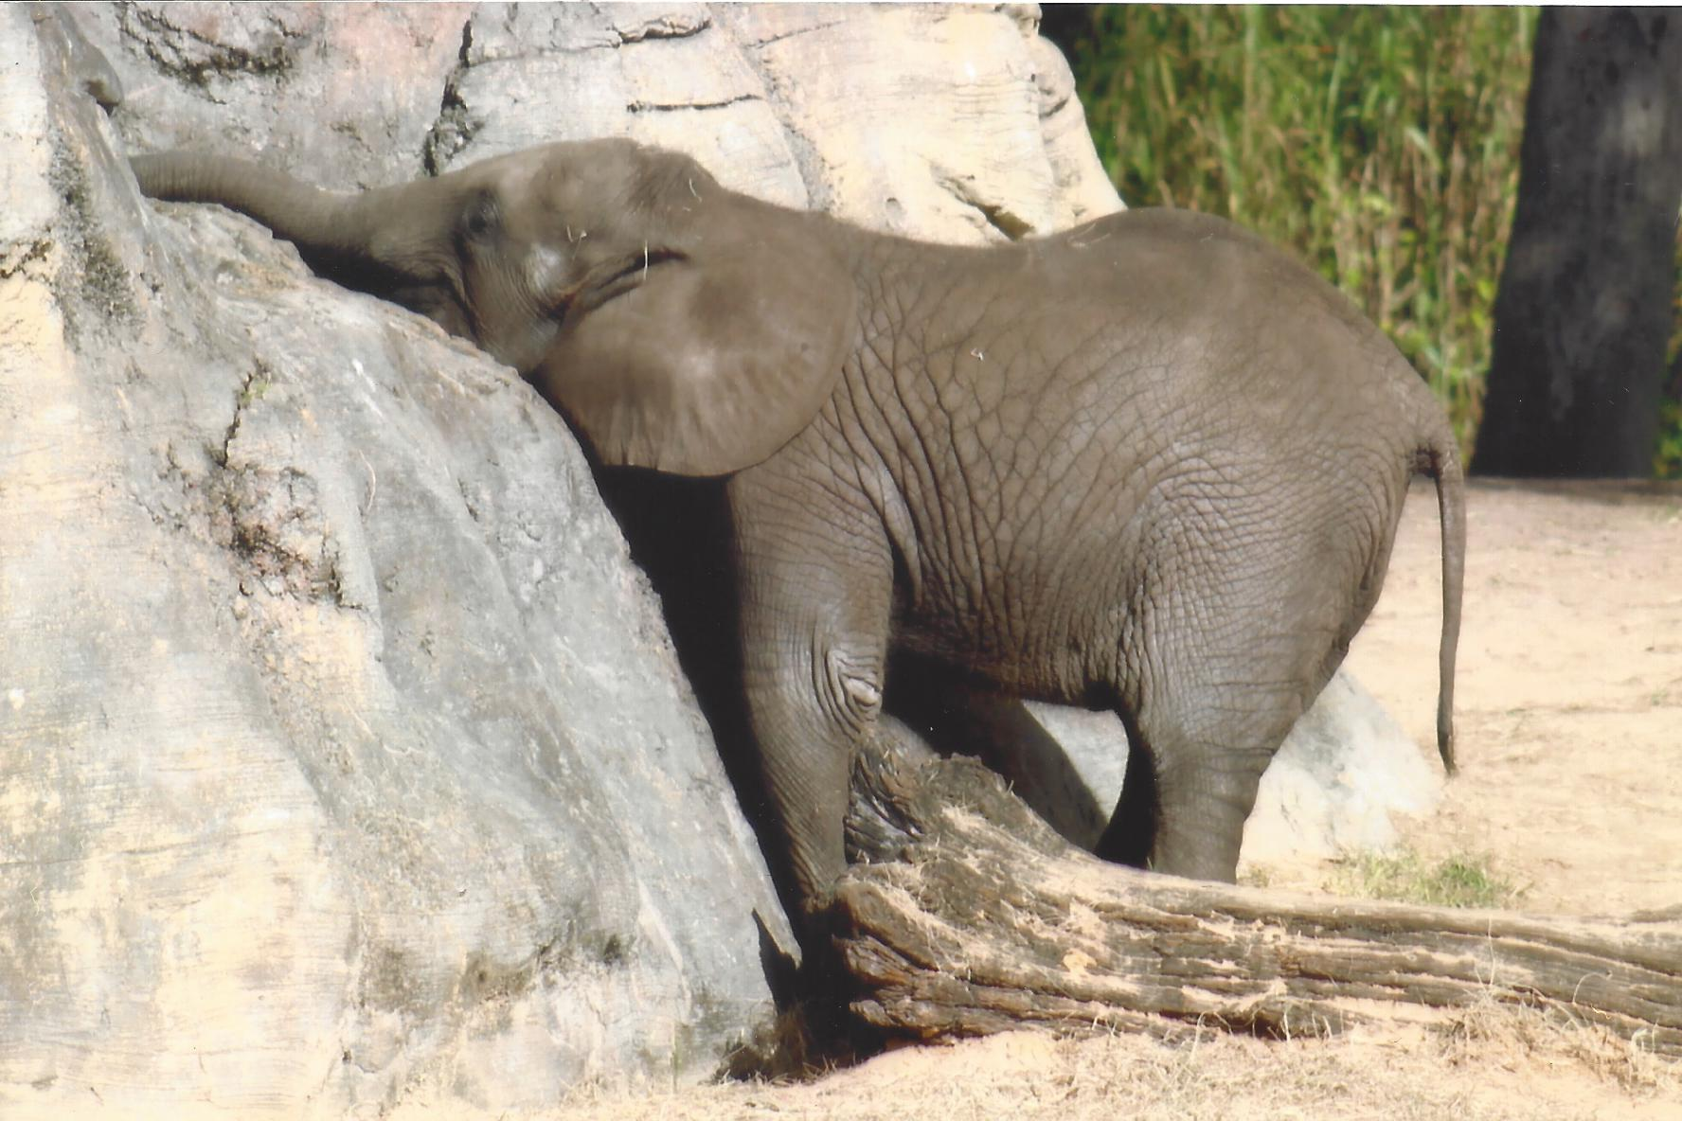

Slide 14
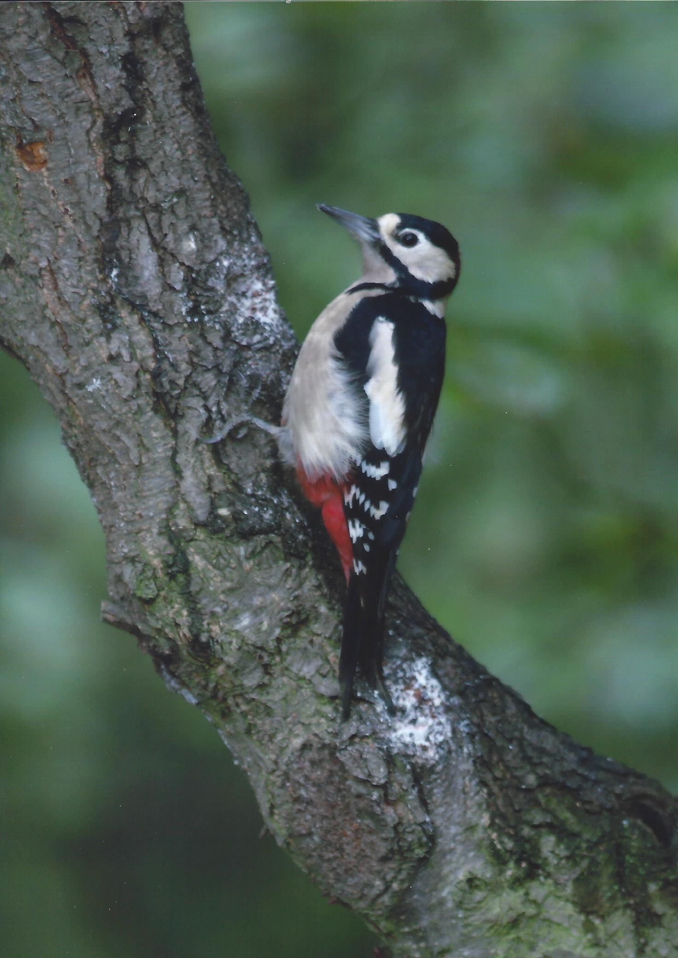

Slide 15
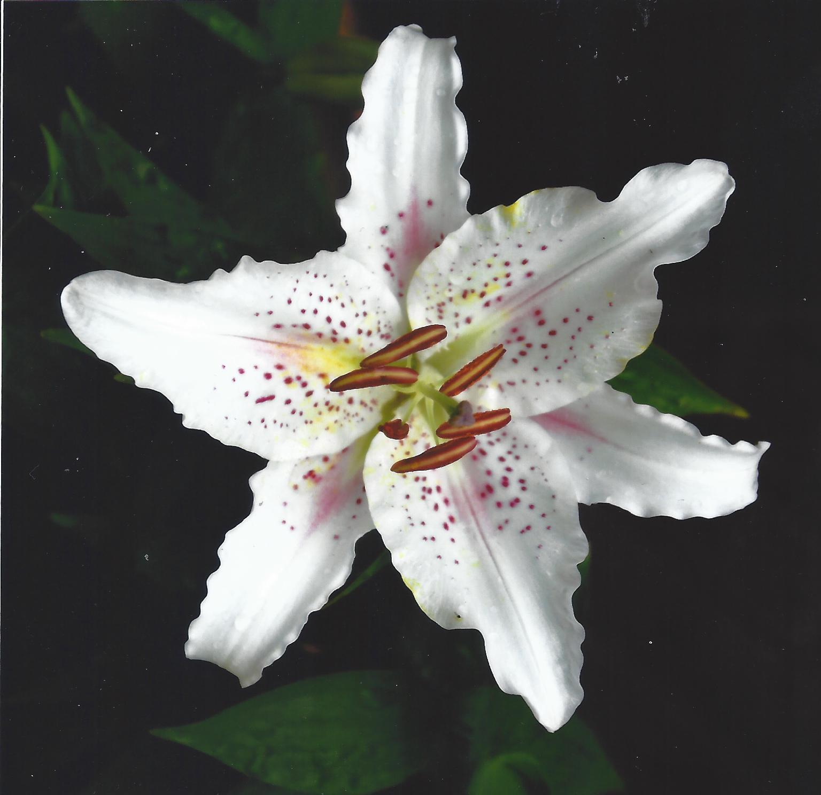

Slide 16
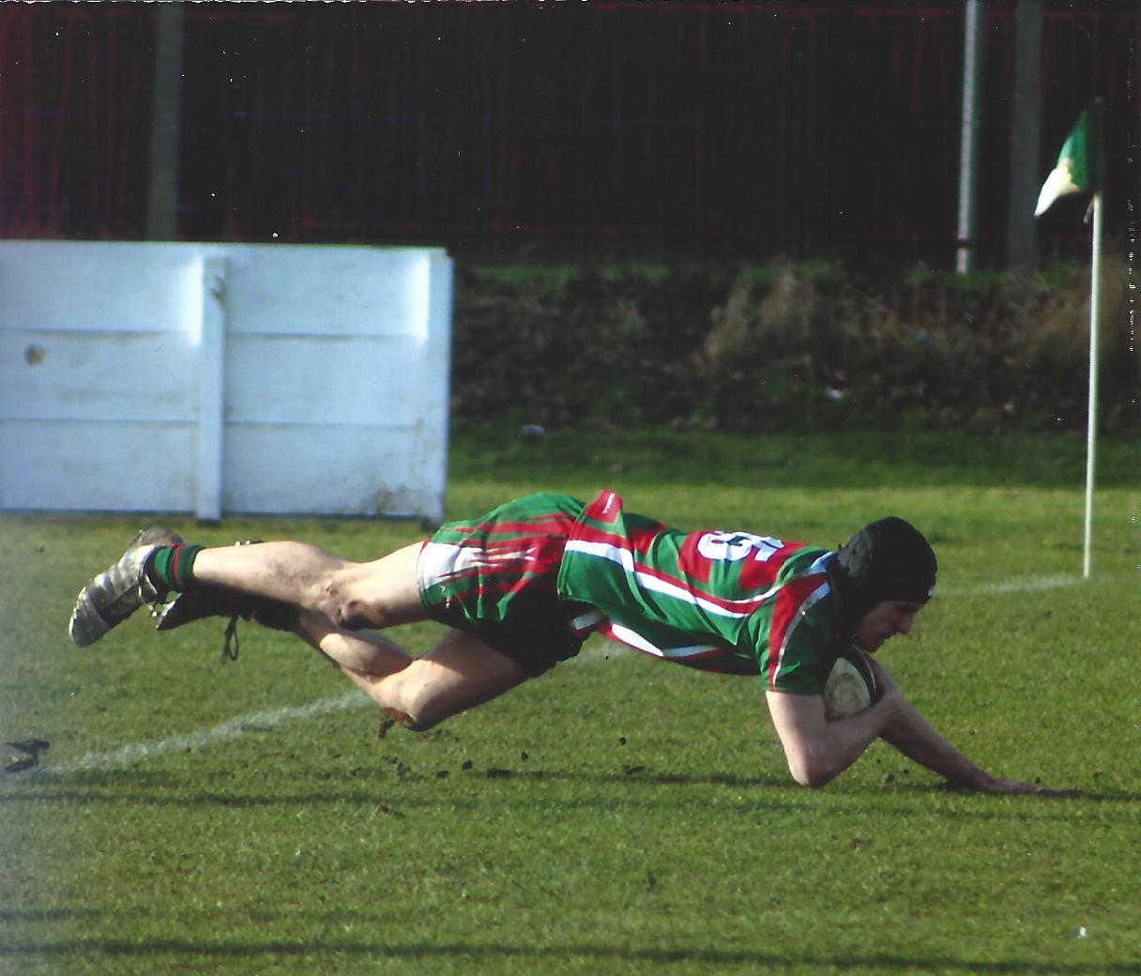

Slide 17
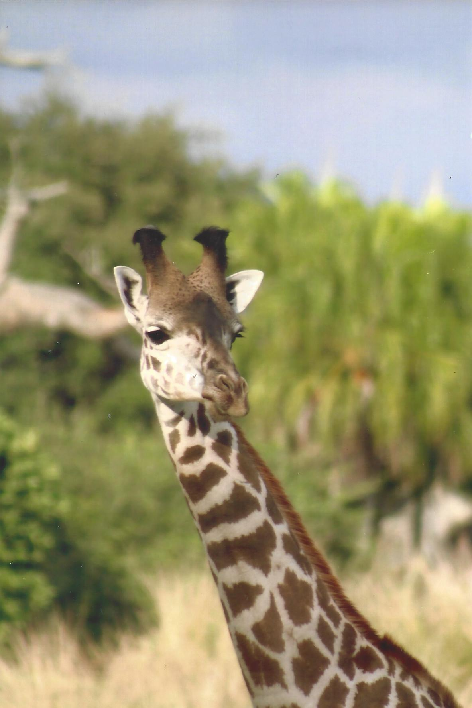

Slide 19
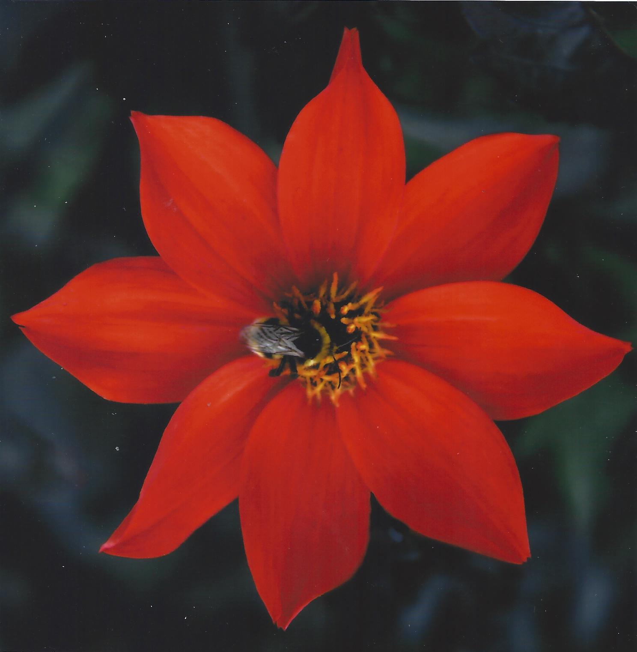

Slide 20
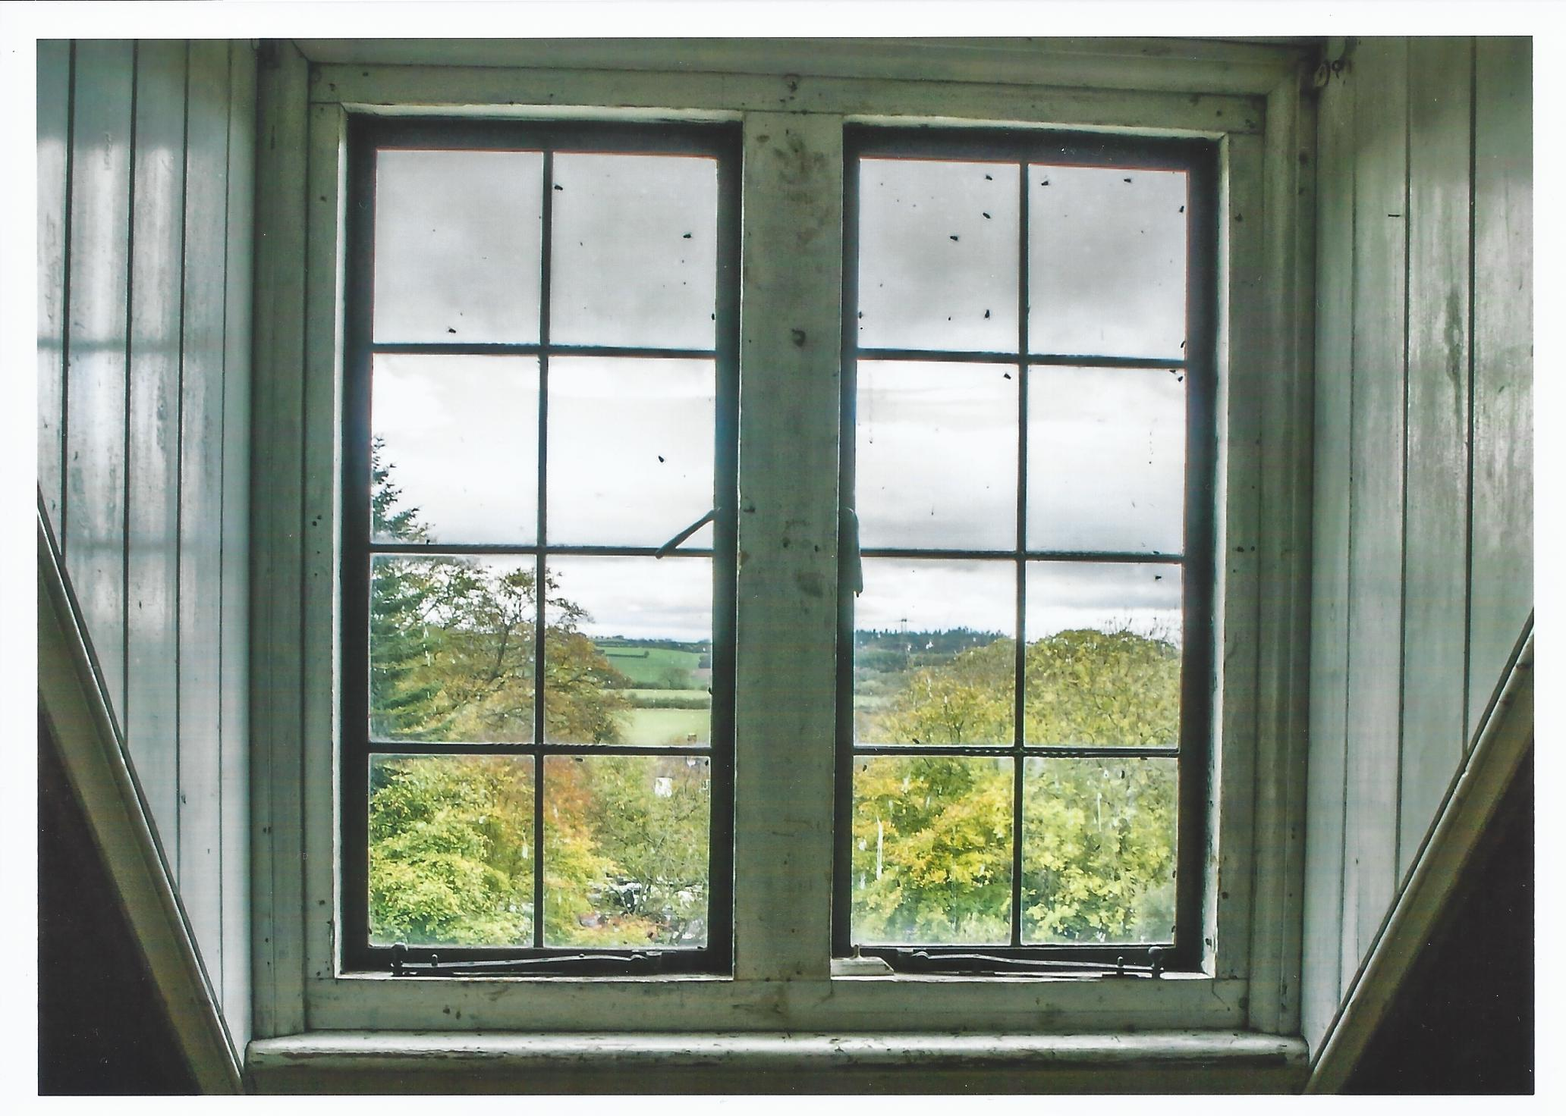

Slide 23
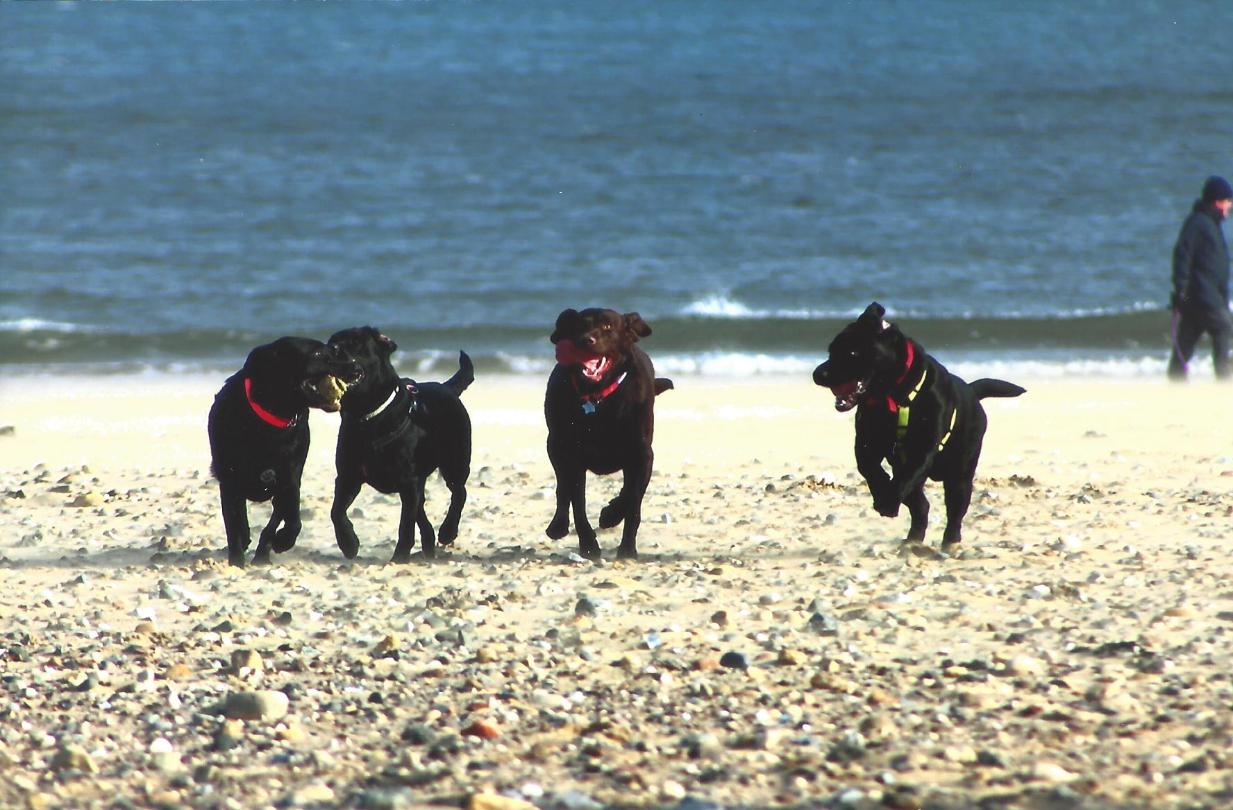

Slide 25
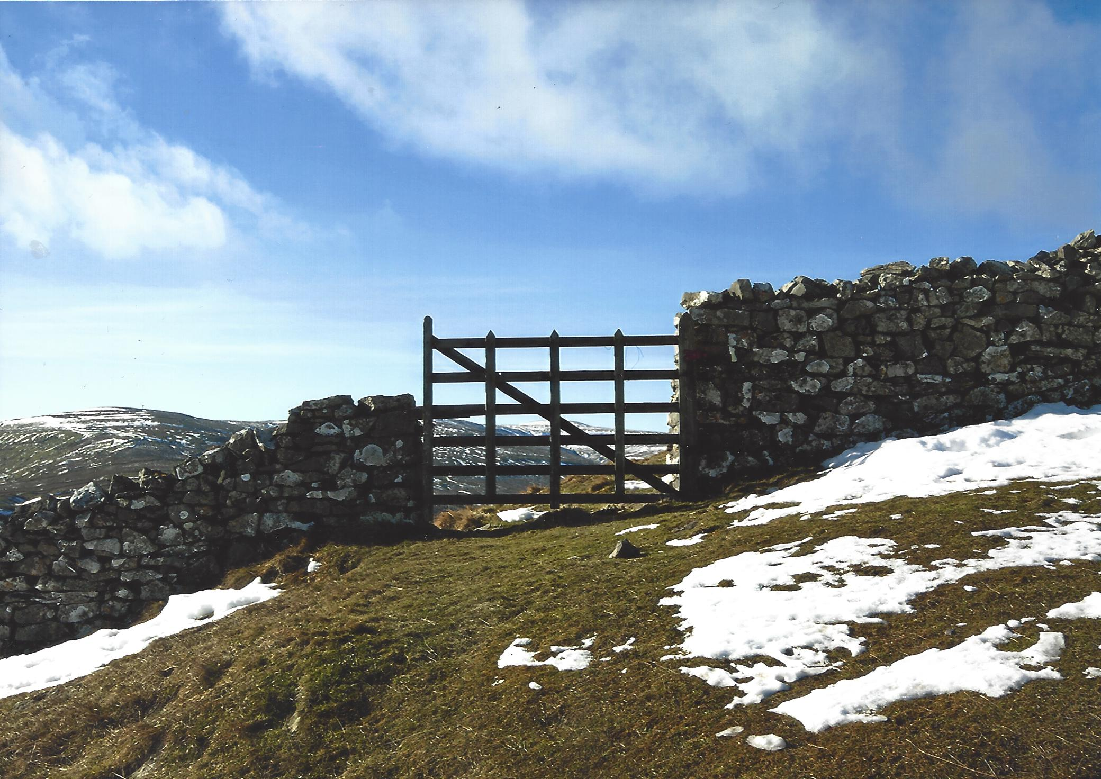

Slide 26
Unmanipulated Results

Slide 27
Highly Commended

Slide 28
David Treveil

Slide 29
George Wood

Slide 30
????

Slide 31
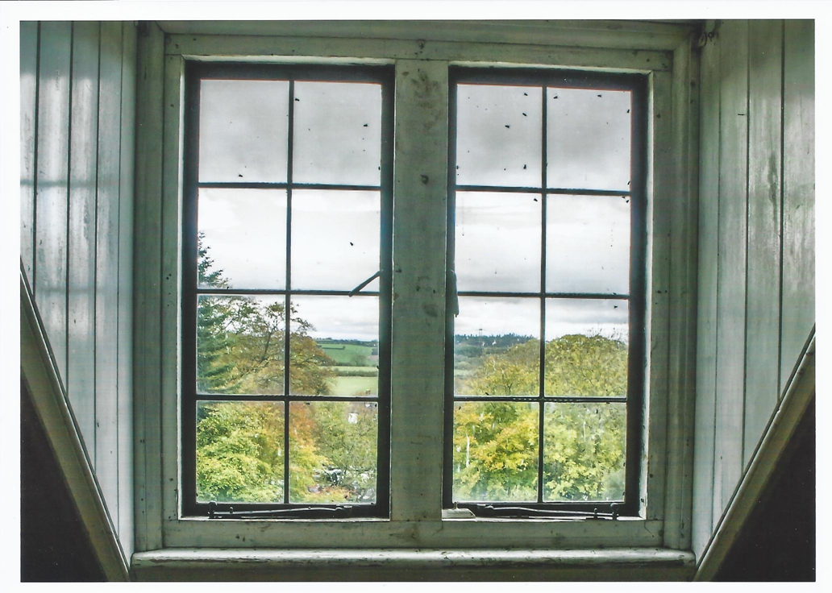
Caroline Wray

Slide 32
Top Spots
From 6th Place
To
1st Place

Slide 33
In 6th Place
Garreth Waites

Slide 34
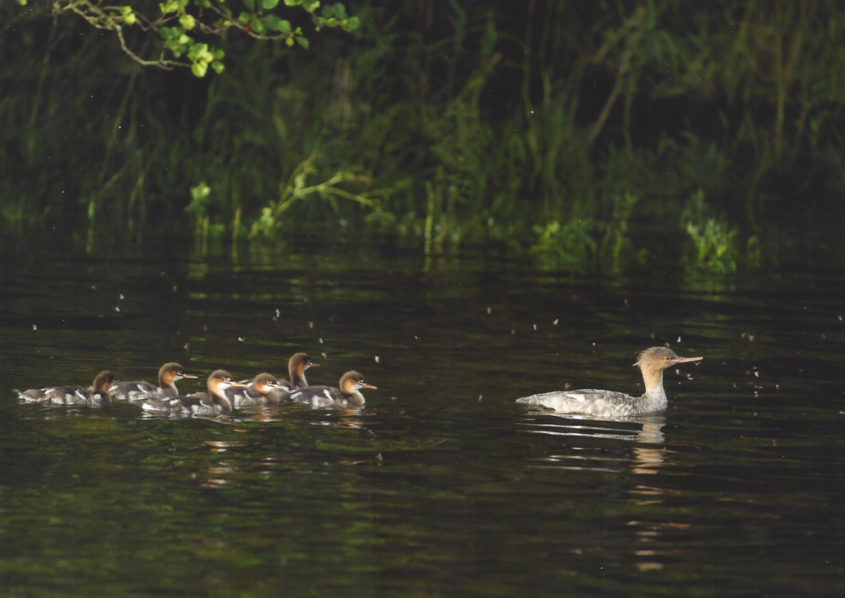
In 5th Place
?????

Slide 35
In 4th Place
Alan Musgrove

Slide 36
In 3rd Place
Alan Musgrove

Slide 37
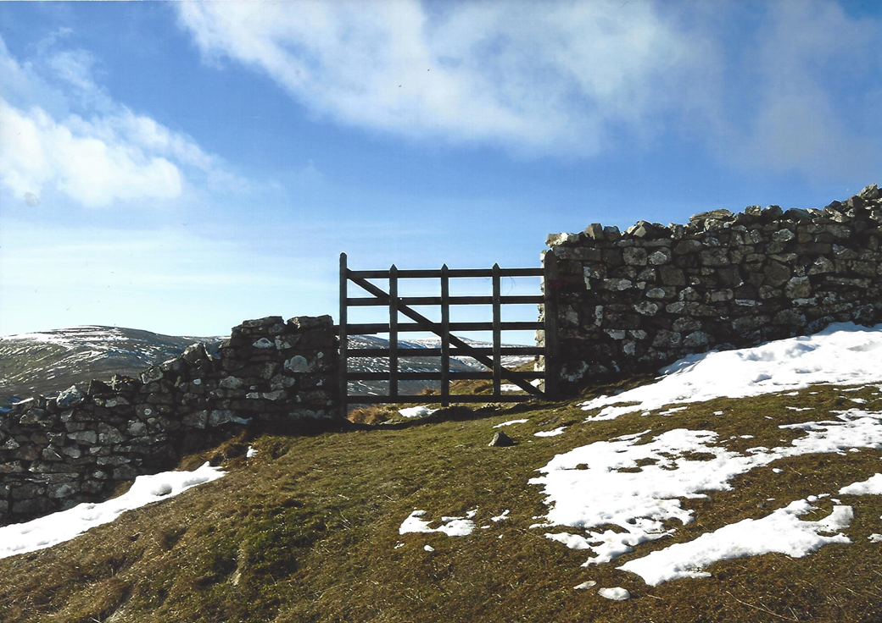
In 2nd Place
Ray Swales

Slide 38
In 1st Place
Caroline Wray

Slide 39
March Unmanipulated Enprint Competition
Thank you for your attention
Next Enprint is to be held on Monday 1th April
Entries to be in 25th March
See you then

